Slide 1
Getting to Know Luxembourg
December 2018

Slide 2
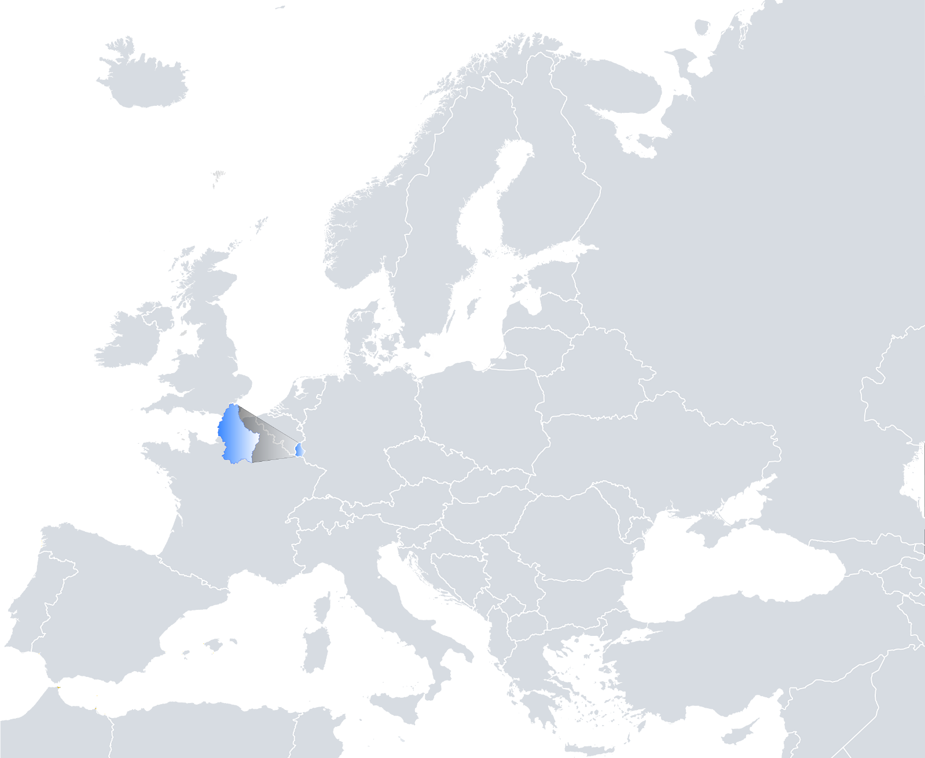
Luxembourg – at the Heart of Europe
Notes:
SPEAKER NOTES
Before starting the PowerPoint presentation, the videos Visit Luxembourg (duration: 1’35’’): www.inspiringluxembourg.public.lu/fr/outils/videos/Visit-Luxembourg/index.html Welcome to Luxembourg (duration : 2’36’’) luxembourg.public.lu/de/photos-videos/videos/Is_it_true-Welcome/index.html can be screened.
The contents of this PowerPoint presentation are freely available to the speaker who may, if desired, prepare a customised PowerPoint presentation by choosing those slides that are of interest to the target audience.
This PowerPoint presentation contains audio files on slides 24, 25, 29 and 37. To be able to listen to them, you need to unzip the associated audio files first.
LEGAL NOTICE
The contents of this PowerPoint presentation have been prepared by the Service information et presse du gouvernement luxembourgeois (SIP – Information and Press Service of the Luxembourg government). They come from the portals www.luxembourg.lu, www.inspiringluxembourg.public.lu, www.gouvernement.lu as well as from publications issued by the SIP and the Luxembourg government. These contents are protected by the laws on intellectual property, in particular the amended law of 18 April 2001 on copyright. The objective of the SIP is to provide accurate and up-to-date information; however, it cannot rule out any errors or a failure to update.
© Service information et presse du gouvernement luxembourgeois, all rights reserved, December 2018

Slide 3
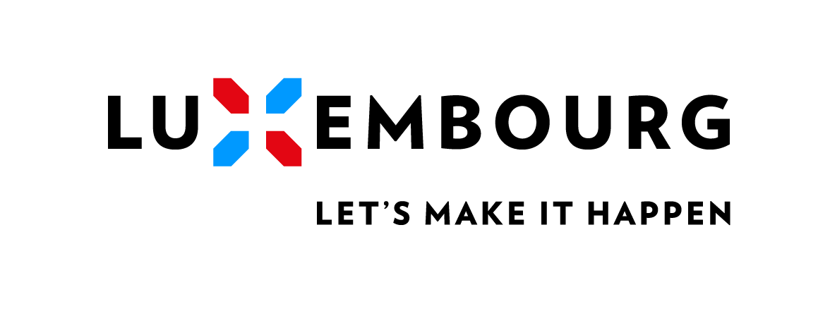
Contents
At a Glance
Geography
Political System
Luxembourg in the World
History
Population
Values of the Luxembourg people
Linguistic Situation
National Symbols
Festivals and Traditions
Famous Luxembourg people
Did you know that…?

Slide 4
At a Glance
Official name: Grand Duchy of Luxembourg
Capital: Luxembourg (116,328 inhabitants)
Neighbouring countries: Belgium, France, Germany
Area: 2,586 km²
Languages: Luxembourgish (Lëtzebuergesch), French, German
Population:
602,000 inhabitants;
more than 170 nationalities; percentage of foreigners: 47.9%.
Time zone: GMT/UTC +1
Currency unit: euro
Notes:
At a Glance
Official name: Grand Duchy of Luxembourg. Independent since 1839, it is the world’s only grand duchy.
Capital: Luxembourg (116,328 inhabitants as of 31.12.2017)
Neighbouring countries: Belgium, France, Germany
Area: 2,586 km². Luxembourg measures a maximum of 82 km (50.95 miles) from north to south and 57 km (35.42 miles) from east to west.
Languages: Luxembourgish (Lëtzebuergesch – national language); French, German, Luxembourgish (administrative languages); the majority of the Grand Duchy’s inhabitants are multilingual, speaking additional languages not mentioned above, e.g. English. Added to this are languages spoken by the non-Luxembourg communities, such as Portuguese or Italian.
Population (as of 1.1.2018):
- 602,000 inhabitants;
- more than 170 nationalities;
- percentage of foreigners: 47.9%.
Time zone: GMT/UTC +1
Currency unit: euro (1 euro = 100 cents)
FOR MORE INFORMATION
“Luxembourg, an Overview”: www.luxembourg.public.lu/en/le-grand-duche-se-presente/luxembourg-tour-horizon/index.html
Everything you need to know about the Grand Duchy of Luxembourg: www.luxembourg.public.lu/en/publications/c/tout-savoir/index.html

Slide 5
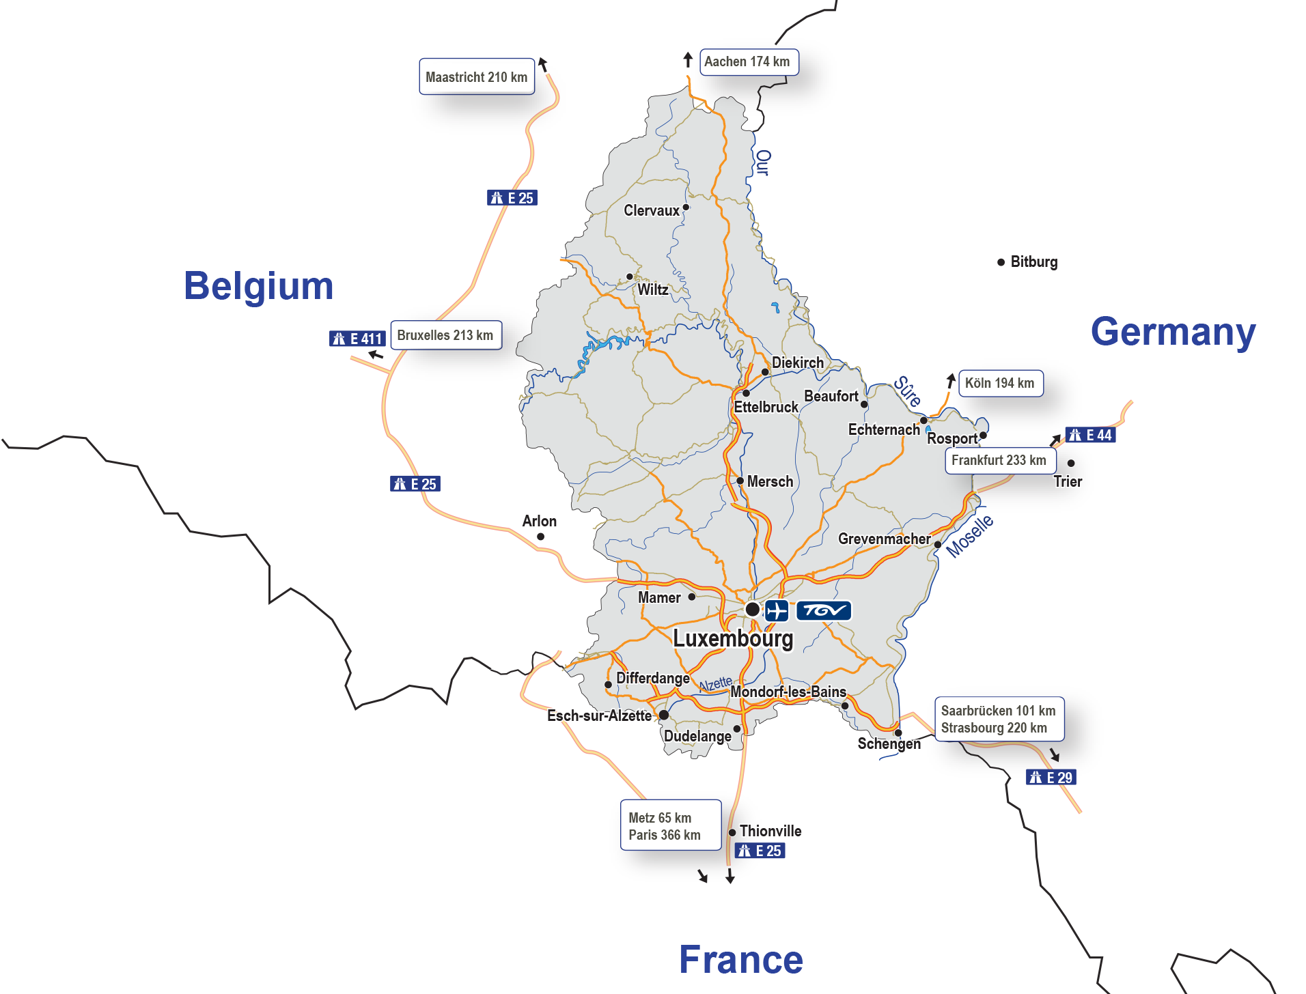
At a Glance
Luxembourg, easily accessible
Notes:
At a Glance: Luxembourg, easily accessible
Luxembourg is situated between Belgium, Germany and France. It is well connected to the major European cities and easily accessible by air, rail and road.
- Continuously growing international airport;
- Dense national road and railway network connected to all of Europe;
- TGV link with Paris and Strasbourg; since 2016 with towns in southern France.
FOR MORE INFORMATION
“Transport and Mobility”: www.luxembourg.public.lu/en/le-grand-duche-se-presente/luxembourg-tour-horizon/transports-mobilite/index.html

Slide 6
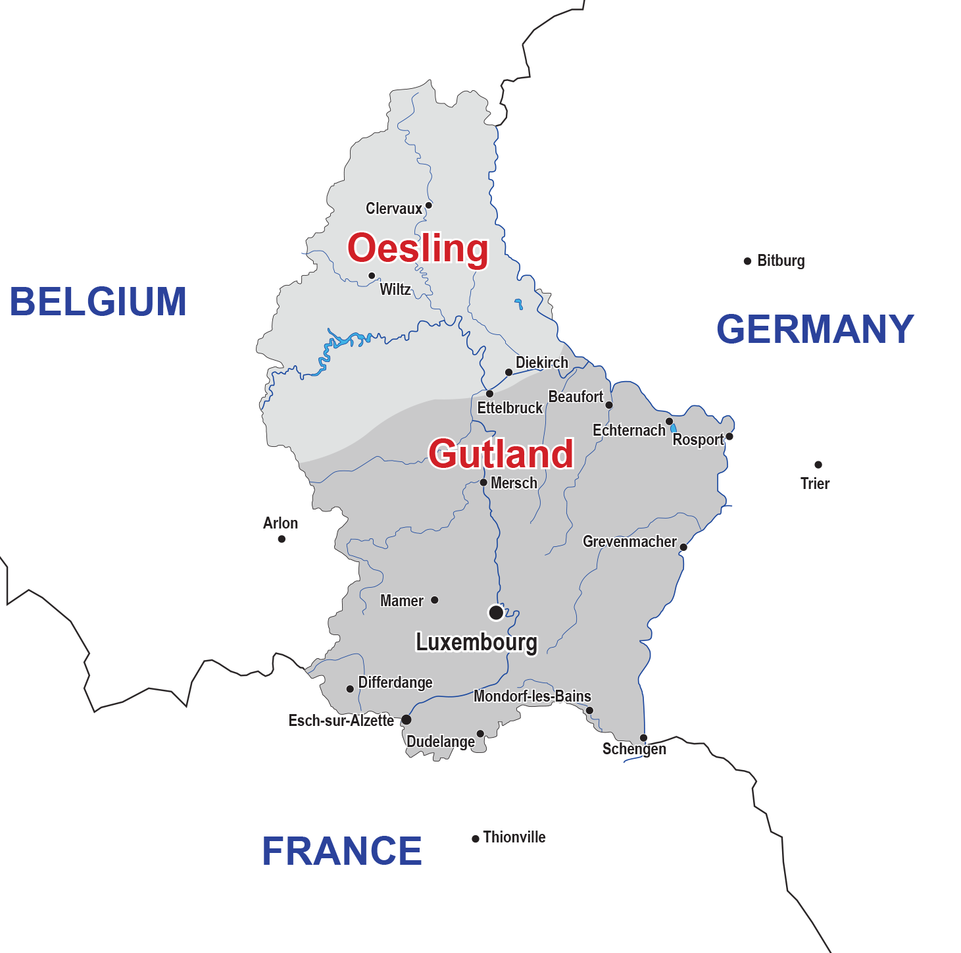
Geography
Area: 2,586 km²
Neighbouring countries: Belgium, France and Germany
Two natural regions: Oesling (north) and Gutland (west, south and east)
Oesling: wooded region, rivers and lakes, 2 nature reserves
Gutland: open countryside and forests, 1 nature reserve
Climate: temperate
Notes:
Geography
Area: 2,586 km². Luxembourg measures a maximum of 82 km (50.95 miles) from north to south and 57 km (35.42 miles) from east to west.
Bordered by Belgium, France and Germany, the Grand Duchy is located in the heart of Western Europe.
The Grand Duchy is home to two natural regions: the Oesling in the north, and the Gutland, which includes the Valley of the Seven Castles in the west, the Mineral Basin in the south and the valley of the Moselle in the east.
Oesling (in the north, part of the Ardennes): wooded region, rivers and lakes; Upper Sûre and Our nature reserves; main towns: Ettelbruck, Wiltz, Diekirch and Clervaux.
Gutland: open countryside and forests, Valley of the Seven Castles and forests (in the west); The Land of the Red Rocks (in the south); valley of the Moselle (in the east), region Mullerthal – Luxembourg’s Little Switzerland with its Naturpark Mëllerdall nature reserve (in the east); main cities and towns: the capital Luxembourg, Esch-sur-Alzette, Dudelange, Differdange.
Climate: Luxembourg enjoys a temperate climate. Average annual temperatures range from -2.6°C (average minimum value) to 21.6°C (average maximum value) (1981-2010 figures). June, July and August are the hottest months, July and August the sunniest. In summer, temperatures range from 12°C to 35°C. In winter, temperatures fluctuate between -10°C and 15°C. In September and October, Luxembourg often experiences its own Indian summer.
FOR MORE INFORMATION
“Geography and Climate”: www.luxembourg.public.lu/en/le-grand-duche-se-presente/luxembourg-tour-horizon/geographie-et-climat/index.html
Everything you need to know about the Grand Duchy of Luxembourg: www.luxembourg.public.lu/en/publications/c/tout-savoir/index.html

Slide 7
Political System
Form of government: parliamentary democracy in the form of a constitutional monarchy
Constitution: Constitution of the Grand Duchy of Luxembourg of 17 October 1868, amended on several occasions
Universal suffrage: introduced in 1919
Head of state: HRH Grand Duke Henri
Parliament (Chamber of Deputies): 60 members
Head of government: Xavier Bettel, Prime Minister, Minister of State
Ruling parties (since 2013, re-elected in 2018): coalition government between the Democratic Party (DP), the Luxembourg Socialist Workers’ Party (LSAP) and the Green Party (déi gréng)
Separation of powers
Notes:
Political System
- The form of government is that of a parliamentary democracy in the form of a constitutional monarchy. The laws passed by Parliament are promulgated and published by the Grand Duke.
- The Constitution of the Grand Duchy of Luxembourg dates back to 17 October 1868 (amended several times since).
- Universal suffrage was introduced in 1919.
- The head of state is HRH Grand Duke Henri (acceded to the throne on 7 October 2000).
- Parliament (known as the Chamber of Deputies) is composed of 60 members.
- Xavier Bettel has been the head of government since December 2013.
The ruling parties, which have been in power since 2013, and re-elected in 2018, are the Democratic Party (DP), the Luxembourg Socialist Workers’ Party (LSAP) and the Green Party (déi gréng). Prior to this date and since 1919, the Christian Social Party (CSV or Party of the Right prior to 1945) led all the government coalitions, with two exceptions (1925-1926 and 1974-1979).
- Separation of powers: As in every parliamentary democracy, the separation of powers is flexible in Luxembourg. There are many links between the legislative and executive powers. Only the judicial power remains completely independent.
FOR MORE INFORMATION
“Political System”: https://gouvernement.lu/en/systeme-politique.html
“Political System”: www.luxembourg.public.lu/en/le-grand-duche-se-presente/systeme-politique/index.html
About... Political Institutions in Luxembourg: www.luxembourg.public.lu/en/publications/d/ap-institutions-politiques/index.html
Everything you need to know about the Grand Duchy of Luxembourg: www.luxembourg.public.lu/en/publications/c/tout-savoir/index.html

Slide 8
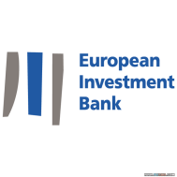
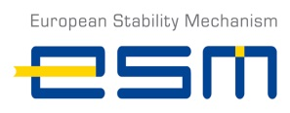
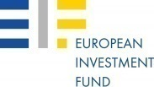
Luxembourg in the World
Greater Region: Luxembourg = economic, financial and commercial hub of the cross-border Greater Region
Luxembourg, one of the three ‘capitals’ of the European Union
European institutions
Founding member of several international organisations
Member of all major international organisations
Luxembourg, non-permanent member of the United Nations Security Council (2013-2014)
Official development assistance (ODA): contribution of approximately 1% of GNI
Notes:
Luxembourg in the World
- The Grand Duchy is the economic, financial and commercial hub of the cross-border Greater Region (Lorraine, Saar, Rhineland-Palatinate, Wallonia and the Grand Duchy of Luxembourg). As an example, during the week over 180,000 German, French and Belgian cross-border commuters travel to Luxembourg on a daily basis for work.
Alongside Brussels and Strasbourg, Luxembourg is one of the three “capitals” of the European Union. The capital is home to several European services and institutions, including services of the European Commission (translation, publication, statistics), the European Court of Auditors, the Court of Justice of the European Union, the European Investment Bank (EIB), the European Investment Fund, the Secretariat of the European Parliament, the European Financial Stability Facility (EFSF) and the European Stability Mechanism (ESM).
- Luxembourg is a founding member of several international organisations, such as the Benelux Union, the Council of Europe, the precursor institutions of the European Union (the ECSC, the EEC, Euratom), NATO, the OECD, the UN... and a member of all major international organisations.
- On 18 October 2012, Luxembourg was elected for the first time in its history by the United Nations General Assembly to occupy a seat as a non-permanent member on the Security Council for the 2013-2014 period. During the month of March 2014, the Grand Duchy took over the presidency of the Security Council.
- Official development assistance: Luxembourg’s international commitment is reflected notably in the field of official development assistance, which has amounted to approximately 1% of gross national income (GNI) since 2009, ranking the Grand Duchy among the five countries in the world that spend over 0.7% of their GNI on development cooperation.
FOR MORE INFORMATION
“Luxembourg and the European Union”: www.luxembourg.public.lu/en/le-grand-duche-se-presente/luxembourg-monde/luxembourg-europe/index.html
“Luxembourg in the world”: www.luxembourg.public.lu/en/le-grand-duche-se-presente/luxembourg-monde/index.html
About… Luxembourg and the European Union: www.luxembourg.public.lu/en/publications/p/ap-europe/index.html
Everything you need to know about the Grand Duchy of Luxembourg: www.luxembourg.public.lu/en/publications/c/tout-savoir/index.html

Slide 9
History
Key moments
963: Lucilinburhuc and the origins of Luxembourg
Luxembourg = condensed version of European history
In the Middle Ages (14th to 15th century): at the head of the Holy Roman Empire
Early modern period: “Gibraltar of the North” and foreign domination
Province of the Netherlands (15th to 18th century)
1839: sovereign and independent state
After 1945: key role in European construction
Notes:
History: Key moments
- The origins of Luxembourg date back to 963 when Count Siegfried acquired the small fort of Lucilinburhuc through a deed of exchange with the abbey of St Maximin in Trier. The fort was located on the rocky outcrop of the Bock dominating the valley of the Alzette.
- Situated in the heart of Europe, nestled between France, Belgium and Germany, the country has been involved in the great European developments. The history of the Grand Duchy can thus be considered a condensed version of European history.
- During the Middle Ages, its princes wore the crown of the Holy Roman Empire (14th to 15th century).
- In the early modern period, the fortress of Luxembourg, dubbed “Gibraltar of the North”, was a major bone of contention in the battle between the great powers.
- A province of the Netherlands (15th to 18th century): before gaining independence during the 18th century, Luxembourg successively belonged to the counts, then the dukes of Luxembourg, the dukes of Burgundy, the kings of Spain, the kings of France, the emperors of Austria and the kings of the Netherlands.
1839: Luxembourg became a sovereign and independent state (Treaty of London of 19 April 1839).
- After 1945: key role in European construction.
FOR MORE INFORMATION
“History”: www.luxembourg.public.lu/en/le-grand-duche-se-presente/histoire/index.html
About… History of the Grand Duchy of Luxembourg: www.luxembourg.public.lu/en/publications/b/ap-histoire/index.html

Slide 10
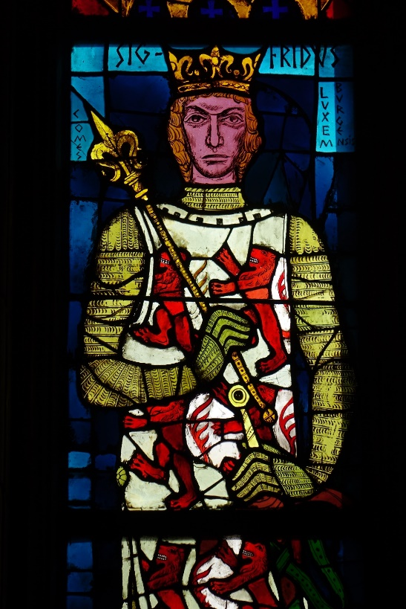
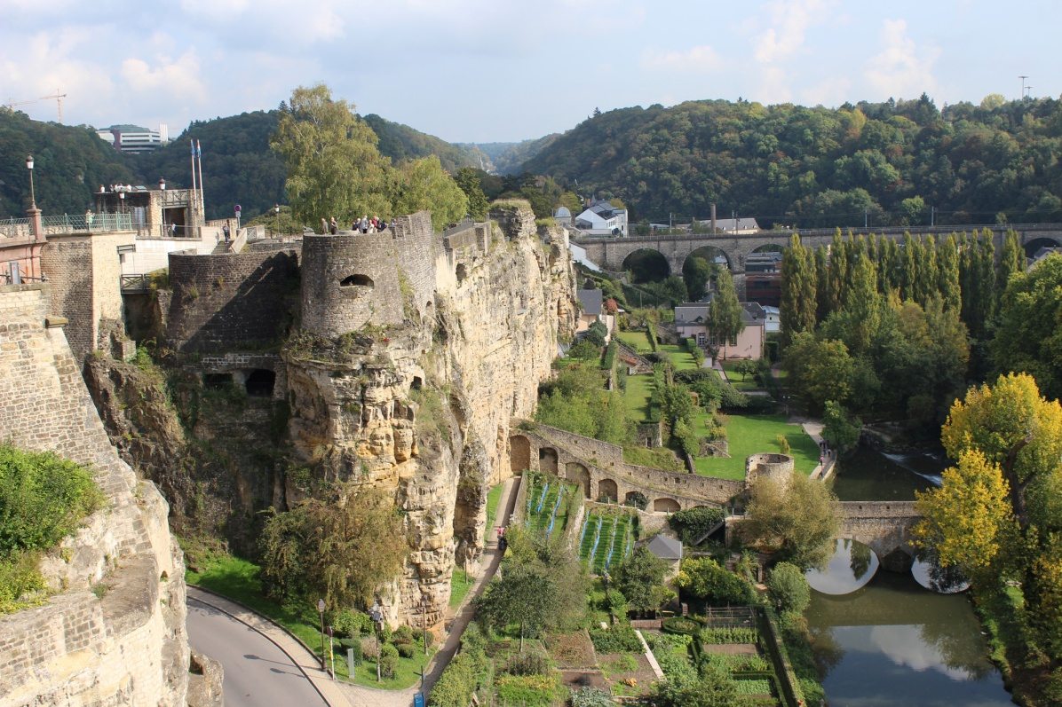
History
Origins date back to 963
Notes:
History: Origins date back to 963 The origins of Luxembourg date back to 963 when Count Siegfried acquired the small fort of Lucilinburhuc through a deed of exchange with the abbey of St Maximin in Trier. The fort was located on the rocky outcrop of the Bock dominating the valley of the Alzette. In 2013, the city of Luxembourg celebrated its 1,050th anniversary. Images: on the left, stained-glass window in Notre-Dame cathedral of Luxembourg featuring Count Siegfried ©cathol.lu/Christophe Hubert;
on the right, view of the Bock outcrop where the small fort of Lucilinburhuc stood © SIP.
FOR MORE INFORMATION
“History”: www.luxembourg.public.lu/en/le-grand-duche-se-presente/histoire/index.html
About… History of the Grand Duchy of Luxembourg: www.luxembourg.public.lu/en/publications/b/ap-histoire/index.html

Slide 11
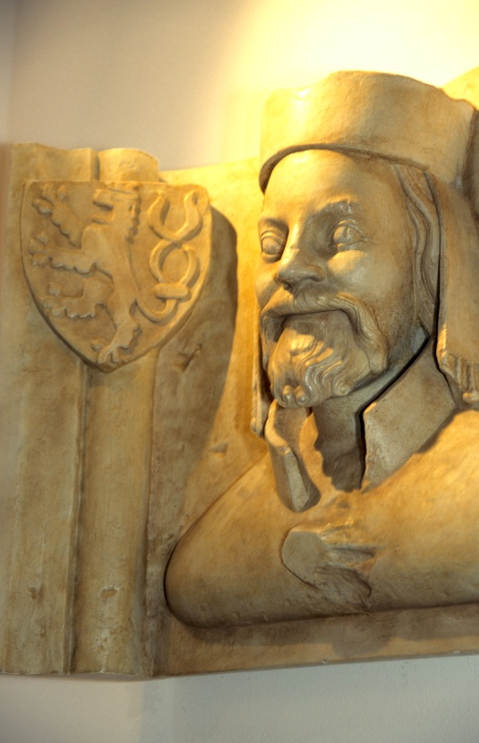
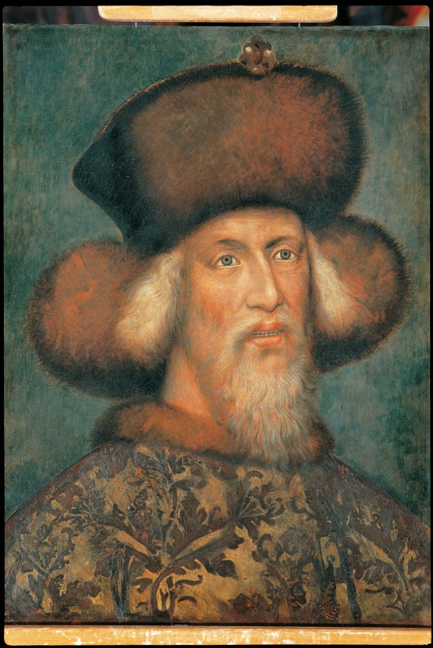
History
The Princes of Luxembourg wore the Crown of the Holy Roman Empire
Henry VII (1308-1313)
Charles IV (1346-1378)
Wenceslas (1376-1400)
Sigismund (1410-1437)
Notes:
History: The Princes of Luxembourg wore the Crown of the Holy Roman Empire
During the Middle Ages, the princes of Luxembourg wore the crown of the Holy Roman Empire (14th to 15th century). Henry VII, count of Luxembourg, was elected king of Germany in 1308 and crowned emperor four years later in Rome. The counts of Luxembourg also became kings of Bohemia through the marriage of the son of Henry VII, John the Blind, to Elisabeth, heiress to the Kingdom of Bohemia. A model knight, John the Blind died a hero’s death in the service of the king of France in the Battle of Crécy in 1346. In 1364, with the definitive acquisition of the County of Chiny, the possessions of the dukes of Luxembourg underwent their greatest expansion (10,000 km²). After Henry VII, three further members of the Luxembourg dynasty went on to wear the imperial crown: Charles IV (1346-1378), Wenceslas (1376-1400) and Sigismund (1410-1437), the last emperor of the house of Luxembourg. Images: on the left, John the Blind, count of Luxembourg, king of Bohemia © SIP/Marcel Schmitz; on the right, Sigismund of Luxembourg © Musée national d’histoire et d’art (MNHA).
FOR MORE INFORMATION
“History”: www.luxembourg.public.lu/en/le-grand-duche-se-presente/histoire/index.html
About… History of the Grand Duchy of Luxembourg: www.luxembourg.public.lu/en/publications/b/ap-histoire/index.html

Slide 12
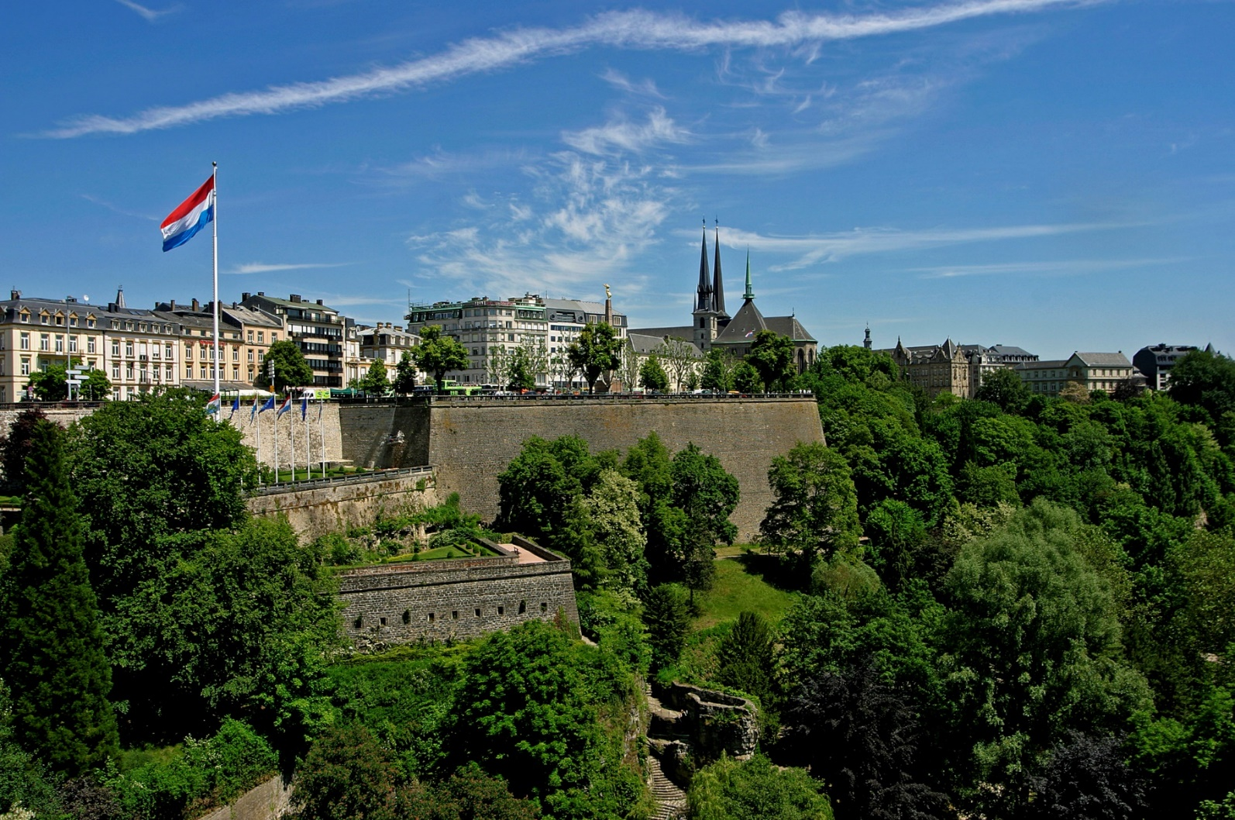
History
“Gibraltar of the North” and foreign domination (15th to 18th century)
Notes:
History: “Gibraltar of the North” and foreign domination (15th to 18th century)
During the early modern period, Luxembourg occupied an important strategic position on the European chessboard. The city of Luxembourg was progressively transformed into one of the most prestigious fortresses of Europe and dubbed “Gibraltar of the North”. Much of the fortification was carried out by renowned French military architect Vauban, who led the siege of Louis XIV’s troops in 1684. In 1715, following the War of the Spanish Succession, Luxembourg fell under Austrian rule. From the 15th to the 18th century, Luxembourg successively belonged to the counts, then the dukes of Luxembourg, the dukes of Burgundy, the kings of Spain, the kings of France, the emperors of Austria and the kings of the Netherlands. Image:
Place de la Constitution with Luxembourg flag © SIP/Christof Weber
FOR MORE INFORMATION
“History”: www.luxembourg.public.lu/en/le-grand-duche-se-presente/histoire/index.html
About… History of the Grand Duchy of Luxembourg: www.luxembourg.public.lu/en/publications/b/ap-histoire/index.html

Slide 13
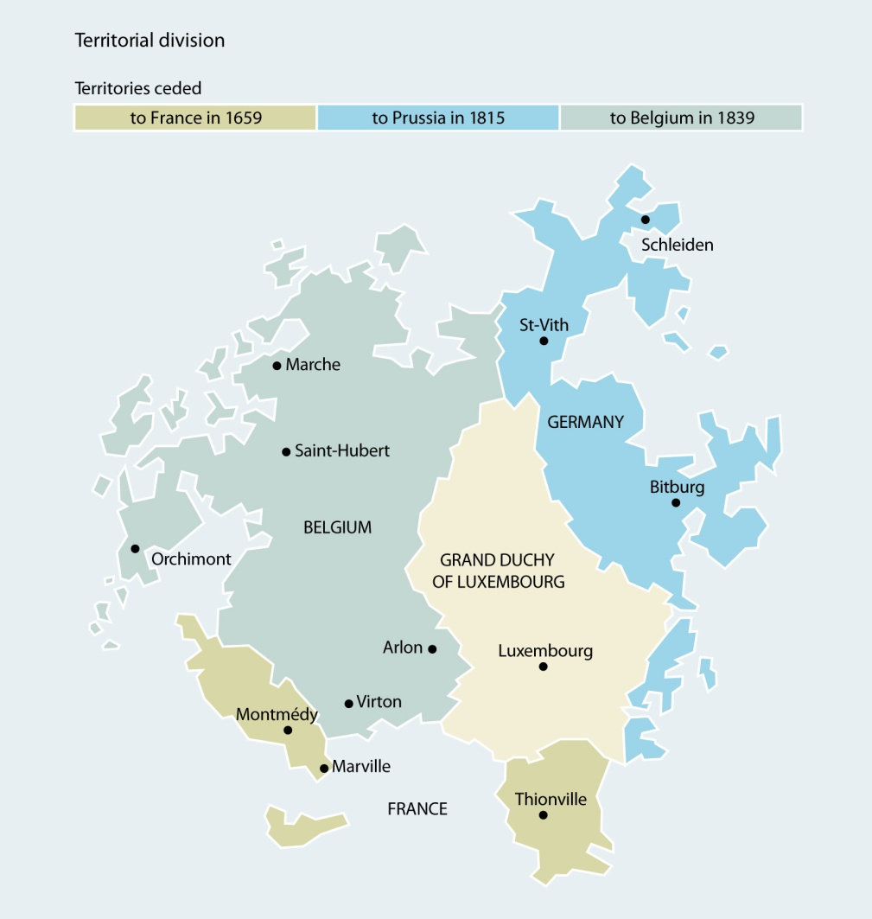
History
Birth of the Grand Duchy of Luxembourg
1815 Creation of the Grand Duchy
1839 Definitive border demarcation
1890 Gaining dynastic independence
Notes:
History: Birth of the Grand Duchy of Luxembourg
1815:
The collapse of the Napoleonic Empire resulted in a redrawing and redistribution of the European map by the great powers gathered at the Congress of Vienna in 1815. This was the moment of the creation of Luxembourg as an independent political entity. It was established as a grand duchy and assigned to the King of the Netherlands, William I of Orange-Nassau. Despite this elevation in rank, the Grand Duchy had to cede the region of the Eifel, as well as a vast region situated to the east of the Moselle, Sûre and Our rivers, to Prussia.
1839:
It was not until 1839, with the Treaty of London, that Luxembourg acquired its current territorial shape. The Grand Duchy of Luxembourg remained under the sovereignty of the Orange-Nassau dynasty, but was granted a separate administration. Belgian Luxembourg became a province of Belgium.
1890:
The personal union with the Netherlands came to an end in 1890, with the death of William III. Adolf of Nassau-Weilburg became Grand Duke of Luxembourg. The country henceforth had its own dynasty.
Image: © SIP/Bizart
FOR MORE INFORMATION
“History”: www.luxembourg.public.lu/en/le-grand-duche-se-presente/histoire/index.html
About… History of the Grand Duchy of Luxembourg: www.luxembourg.public.lu/en/publications/b/ap-histoire/index.html

Slide 14
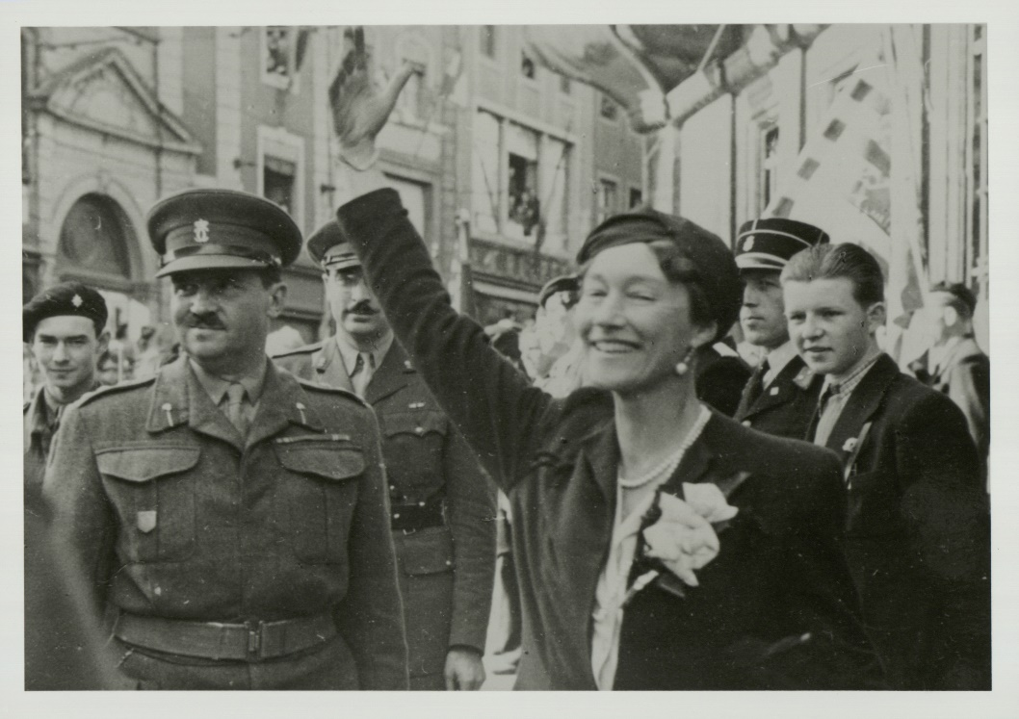
History
20th century – abandoning neutrality
German occupation during both World Wars
Abandon of neutrality after 1945
After 1945: founding member of several international and supranational organisations
2014: 175 years of independence
Notes:
History: 20th century – abandoning neutrality
Despite its neutrality, the Grand Duchy was invaded and occupied during both world wars by German troops, on 2 August 1914 and on 10 May 1940. During the second invasion, Grand Duchess Charlotte and the government went into exile and the country was placed under Nazi occupation. On 10 September 1944, the city of Luxembourg was liberated by the Americans. During the Battle of the Bulge, German forces devastated the north and the east of the country (December 1944 to February 1945). After the Second World War, the Grand Duchy abandoned its status of neutrality and ensured its place within the international community that formed after 1945. It was a founding member of the Benelux Union (1944), the UN (1945), NATO (1949), the ECSC (1951), the EEC and Euratom (Treaties of Rome) (1957), etc. The accession to the throne of Grand Duke Jean in 1964 marked the beginning of an era of exceptional prosperity. Grand Duke Jean abdicated in 2000 in favour of his son Henri. In 2014, Luxembourg celebrated 175 years of independence. Image:
return from exile of HRH Grand Duchesse Charlotte in April 1945, (from left to right) Prince Felix of Bourbon-Parma; Grand Duchesse Charlotte: G. Mirgain © Collections photographiques de la Cour grand-ducale
FOR MORE INFORMATION
“History”: www.luxembourg.public.lu/en/le-grand-duche-se-presente/histoire/index.html
About… History of the Grand Duchy of Luxembourg: www.luxembourg.public.lu/en/publications/b/ap-histoire/index.html

Slide 15
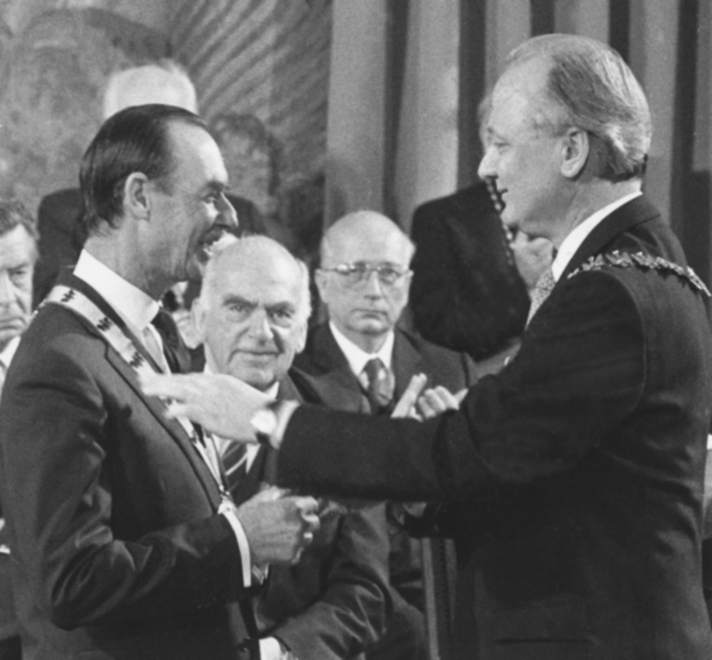
History
20th century – commitment to European integration
Catalyst role in the unification of Europe
One of the six founding members of the European Union
1986: Charlemagne Prize awarded to the people of Luxembourg
Pierre Werner, one of the “forefathers of the euro”
Notes:
History: 20th century – commitment to European integration
Over the course of the second half of the 20th century, the prosperous and dynamic country played a catalyst role in the unification of Europe. Luxembourg was one of the six founding members of the European Union; its people and politicians are often convinced and committed Europeans. As a result, in 1986 the people of Luxembourg were awarded the Charlemagne Prize in recognition of their commitment to Europe.
Pierre Werner is considered one of the ‘forefathers of the euro’ (Werner Plan, 1970). During the 2005 referendum on the Treaty establishing a Constitution for Europe, 56.52% of votes were in favour of the Constitution. Furthermore, Robert Schuman, one of the founding fathers of the European Union, was born in Luxembourg. His birth house, situated at the foot of the Kirchberg plateau, now houses the Robert Schuman Centre for European Studies and Research (CERE). Its scientific library, containing more than 15,000 works on European politics and international relations, is accessible to the general public. Two politicians from Luxembourg, Gaston Thorn and Jacques Santer, have previously held the position of President of the European Commission. As of November 2014, Jean-Claude Juncker is the third Luxembourg citizen to hold this post. Jean-Claude Juncker, Prime Minister from 1995 to 2013, was also the first permanent president of the Eurogroup. He held this position from 2005 to 2013. Currently:
- Jean-Claude Juncker is the president of the European Commission since November 2014.
Yves Mersch is a member of the Executive Board of the European Central Bank (ECB) since December 2012 and this for a period of eight years.
Marc Jaeger is president of the General Court (of the European Union) since September 2007. His re-election for a fourth term covers the period from September 2016 to August 2019. Image:
HRH Grand Duke Jean is awarded the Charlemagne Prize on behalf of the people of Luxembourg (1986) © Luxemburger Wort – Photographe – Jean Weyrich - Reproduction autorisée par luxorr – Toute nouvelle utilisation de ce contenu doit être autorisée à travers : www.luxorr.lu
FOR MORE INFORMATION
“Luxembourg and the European Union”: www.luxembourg.public.lu/en/le-grand-duche-se-presente/luxembourg-monde/luxembourg-europe/index.html
About… Luxembourg and the European Union: www.luxembourg.public.lu/en/publications/p/ap-europe/index.html

Slide 16
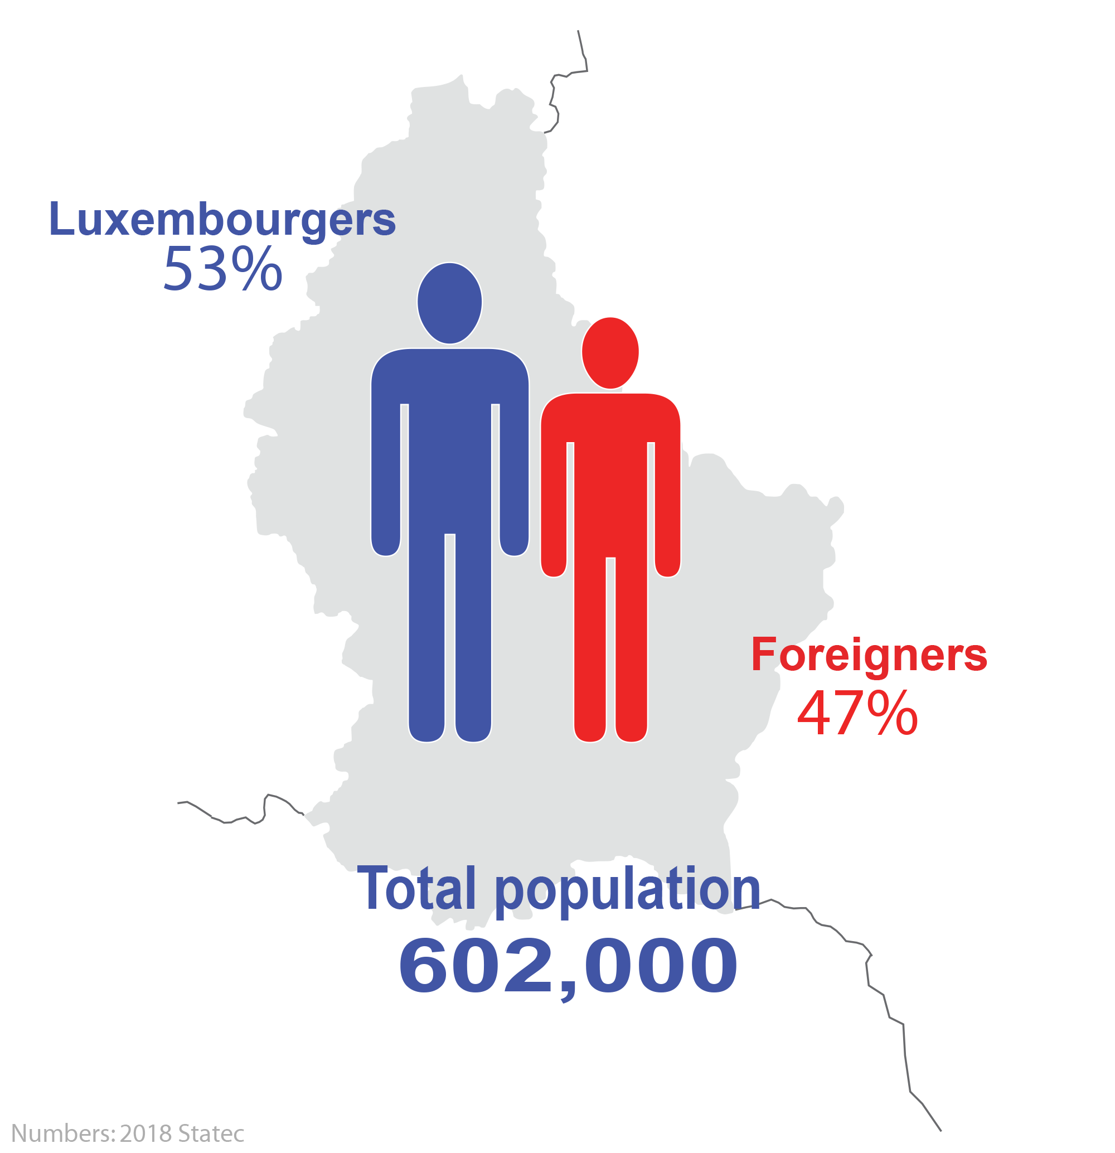
Population
Notes:
Population (as of 1.1.2018)
- Luxembourg has a total population of 602,000 inhabitants;
- 47.9% of the total population does not possess a Luxembourg passport, a proportion approaching 71% in the capital;
Most populated cities: Luxembourg (116,328 inhabitants – 31.12.2017), Esch-sur-Alzette (35,113 inhabitants – 13.08.2018), Differdange (26,387 inhabitants – 2.08.2018).
FOR MORE INFORMATION
“Population”: www.luxembourg.public.lu/en/le-grand-duche-se-presente/population/index.html
“Population et emploi”: www.statistiques.public.lu/fr/population-emploi/index.html (in French)
About... Multicultural Luxembourg: www.luxembourg.public.lu/en/publications/i/ap-lux-multiculturel/index.html

Slide 17
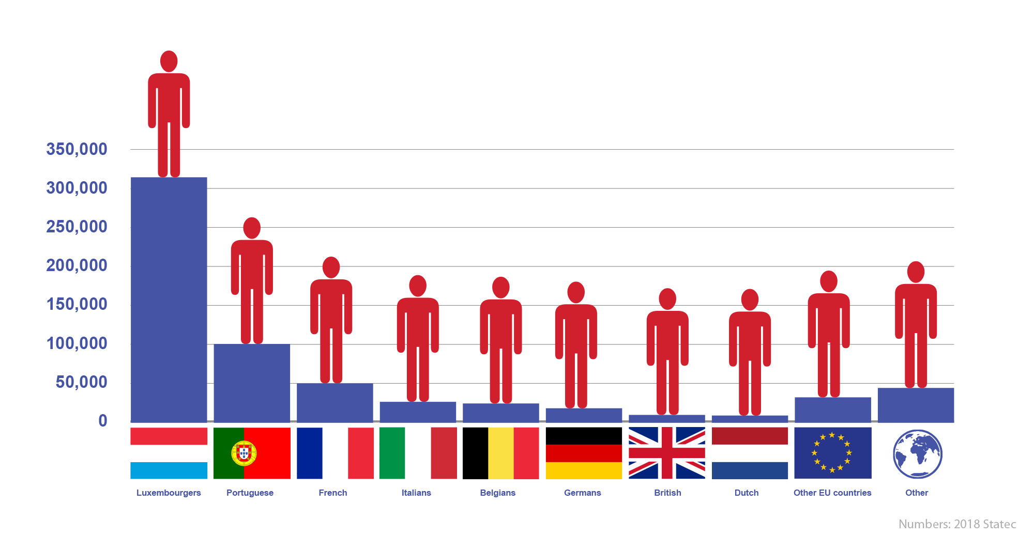
Population
More than 170 nationalities live in Luxembourg
Notes:
Population (as of 1.1.2018)
- More than 170 nationalities live in Luxembourg;
- Close to nine out of ten foreigners hail from European Union member states;
- Proportion of foreigners in the total population:
Portuguese: 16.02%
French: 7.60%
Italians: 3.65%
Belgians: 3.35%
Germans: 2.17%
British: 0.98%
Dutch: 0.71%
Other EU countries: 6.06%
Other: 7.28%
FOR MORE INFORMATION
“Population”: www.luxembourg.public.lu/en/le-grand-duche-se-presente/population/index.html
“Population et emploi”: www.statistiques.public.lu/fr/population-emploi/index.html (in French)
About... Multicultural Luxembourg: www.luxembourg.public.lu/en/publications/i/ap-lux-multiculturel/index.html

Slide 18
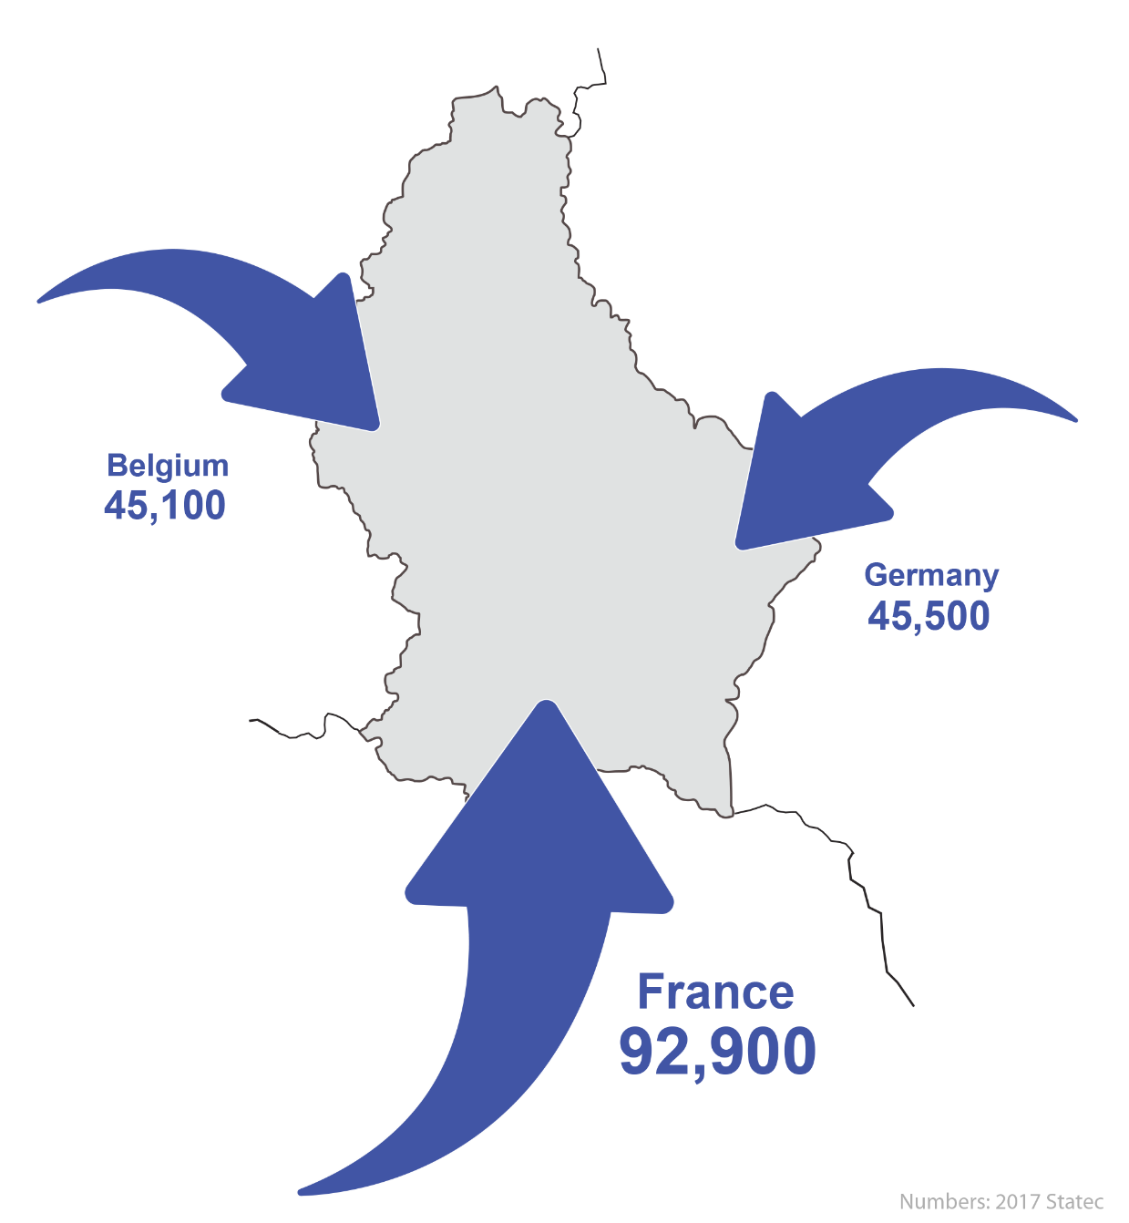
Population
Population and employment
Flow of cross-border commuters
Notes:
Population: Population and employment - During the week, over 180,000 French, German and Belgian cross-border commuters travel to Luxembourg on a daily basis to work in the economic, commercial and financial hub of the Greater Region; - 70% of Luxembourg’s salaried population is made up of cross-border commuters (44%) and foreign residents (26%); - Some 11,000 international civil servants work in Luxembourg’s European institutions (European Parliament, European Commission, Court of Justice of the European Union, European Investment Bank…).
FOR MORE INFORMATION
“Luxembourg Job Market”: www.luxembourg.public.lu/en/travailler/marche-emploi/index.html
“Population et emploi”: www.statistiques.public.lu/fr/population-emploi/index.html (in French)
About... Multicultural Luxembourg: www.luxembourg.public.lu/en/publications/i/ap-lux-multiculturel/index.html

Slide 19
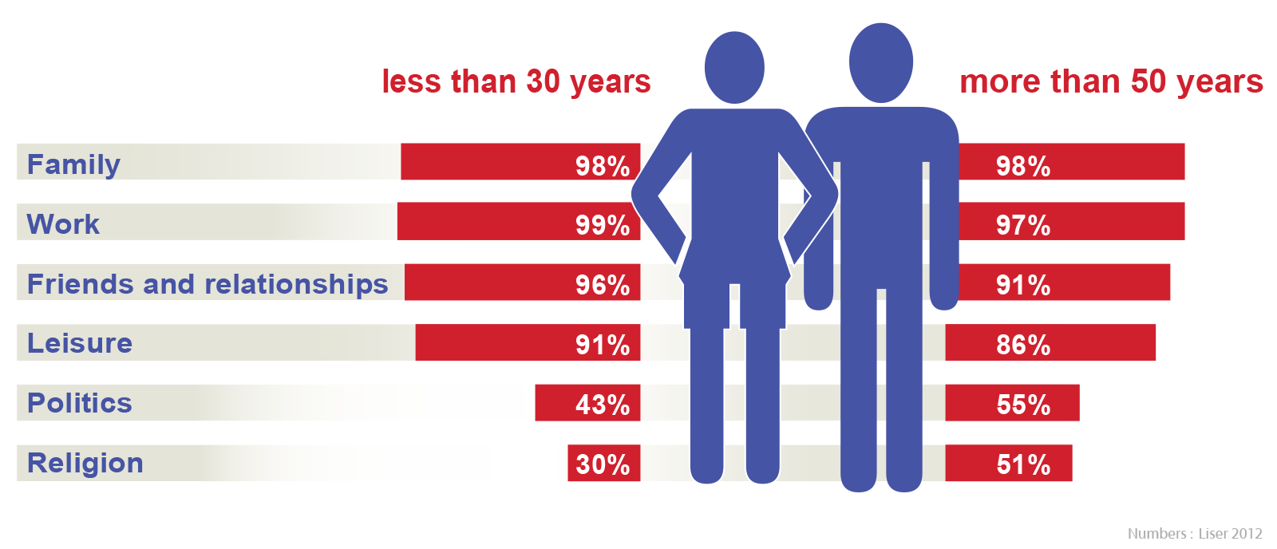
Values of the Luxembourg people
The values of the Luxembourg population by generation
Notes:
Values of the Luxembourg people
The most important values of the Luxembourg people are family, work, friends and leisure. This was revealed in the European Values Study (EVS), which aims to identify and explain the dynamics of changing values in 45 European countries.
The diagram illustrates how the values of younger (under 30) and older (over 50) respondents do not differ significantly, except as far as politics and religion are concerned.
FOR MORE INFORMATION
European Values Study (EVS): www.europeanvaluesstudy.eu
“Etude sur les valeurs au Luxembourg”: www.luxembourg.public.lu/en/actualites/2010/08/12-valeurs/index.html (in French)
Les langues parlées au travail, à l’école et/ou à la maison (Languages spoken at work, at school and/or at home): www.statistiques.public.lu/fr/publications/series/rp2011/2013/13-13-langues/index.html (in French and German)

Slide 20
Linguistic Situation
Official languages and everyday languages
National Language: Luxembourgish (Lëtzebuergesch)
Administrative Languages: French, German and Luxembourgish
Legislative Language: French
Languages spoken in work life: French, German, Luxembourgish, Portuguese
Strategy for the promotion of the Luxembourgish language
Notes:
Linguistic Situation: Official languages and everyday languages
The linguistic situation in Luxembourg is characterised by the use and legal recognition of three languages: Luxembourgish, French and German. The importance of the linguistic coexistence of these languages is an integral part of the national identity.
- National language: Luxembourgish (Lëtzebuergesch), a Moselle Franconian dialect (became the national language following the law of 24 February 1984 on language regime), part of the family of Germanic languages;
- Administrative languages: French, German and Luxembourgish;
- Legislative language: French.
In work life, given that the majority of the working population is foreign (71%), French is the main language of communication, followed by Luxembourgish, German, English and Portuguese.
Strategy for the promotion of the Luxembourg language: In order to promote the Luxembourg language, the Luxembourg government has implemented a long-term strategy, with the aim to achieve a language and culture policy in line with all actors in society. The four major objectives and concrete commitments are:
increasing the importance of Luxembourgish;
advancing the standardisation, use and study of Luxembourgish;
promoting learning Luxembourgish and learning about Luxembourg culture;
promoting culture in the Luxembourg language.
FOR MORE INFORMATION
“Languages”: luxembourg.public.lu/en/le-grand-duche-se-presente/langues/index.html
“Strategy for the Promotion of the Luxembourgish Language”: https://gouvernement.lu/en/dossiers/2018/langue-luxembourgeoise.html
About... Languages in Luxembourg: www.luxembourg.public.lu/en/publications/i/ap-langues/index.html
Everything you need to know about the Grand Duchy of Luxembourg: www.luxembourg.public.lu/en/publications/c/tout-savoir/index.html

Slide 21
Linguistic Situation
Languages in the education system
Public education system: compulsory learning of Luxembourgish, German, French and English
European and international schools
International Baccalaureate (French or English)
Lycée Classique d’Echternach: preparatory class for the French higher education establishments knows as the Grandes Écoles”
University of Luxembourg (French, English, German)
Notes:
Linguistic Situation: Languages in the education system
- The public education system places great emphasis on the learning of languages. The compulsory languages that are taught are Luxembourgish, German, French and English. German is the language of literacy at school.
- There is a broad range of European and international schools for children of foreign residents.
- Certain public and private establishments provide classes in preparation for the International Baccalaureate in French or English.
Since the 2013/2014 school year, the Lycée classique d’Echternach has been offering a preparatory class for the entrance examinations to the French ‘grandes écoles’, higher education establishments with a focus on business and management.
- The University of Luxembourg, with a focus on education and research, is a strong proponent of multilingualism.
FOR MORE INFORMATION
“Languages”: luxembourg.public.lu/en/le-grand-duche-se-presente/langues/index.html
“Which Languages at School?”: luxembourg.public.lu/en/le-grand-duche-se-presente/langues/utilisation-langues/ecole/index.html
“Langues à l’école luxembourgeoise”: www.men.public.lu/fr/themes-transversaux/langues-ecole-luxembourgeoise/index.html (in French)
About... Languages in Luxembourg: www.luxembourg.public.lu/en/publications/i/ap-langues/index.html
Everything you need to know about the Grand Duchy of Luxembourg: www.luxembourg.public.lu/en/publications/c/tout-savoir/index.html

Slide 22
National Symbols
National flag
National anthem
Anthem of the grand-ducal house
National day
Coats of arms
Notes:
National Symbols
The symbols of the state represent and symbolise the identity of the people, their sovereignty, but also their desire to ‘live together’. - National flag - National anthem - Anthem of the grand-ducal house - National day - Coats of arms
FOR MORE INFORMATION
“National Symbols”: www.luxembourg.public.lu/en/le-grand-duche-se-presente/symboles-nationaux/index.html
About... Symbols of the State and the Nation: www.luxembourg.public.lu/en/publications/d/ap-symboles/index.html
Everything You Need to Know about the Grand Duchy of Luxembourg: www.luxembourg.public.lu/en/publications/c/tout-savoir/index.html

Slide 23
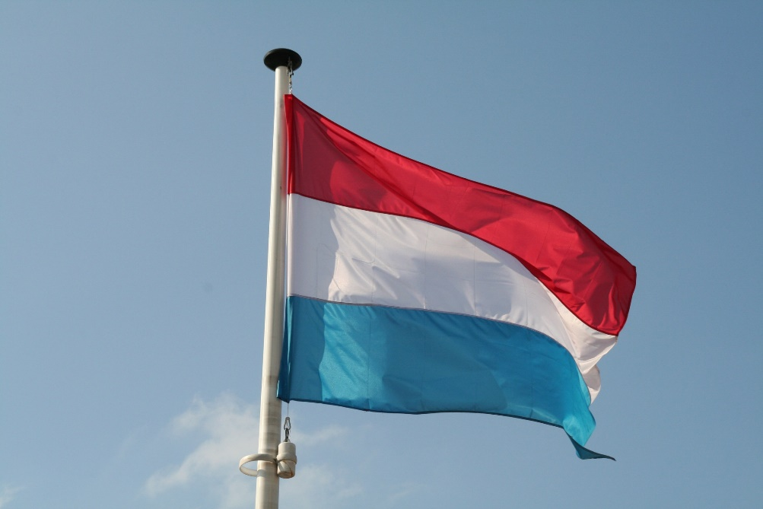
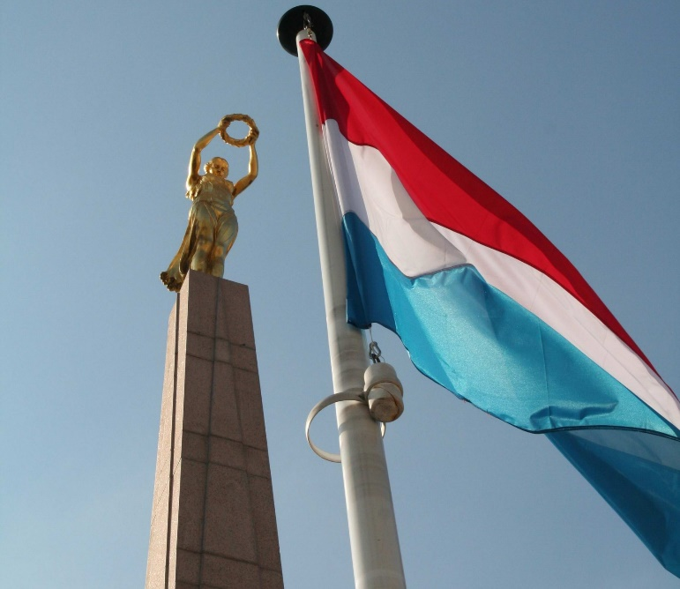
National Symbols
National flag
Notes:
National Symbols: National flag
The national flag is made up of three horizontal bands of red, white and blue. While the Luxembourg flag bears a close resemblance to the flag of the Netherlands, the latter features a distinctive cobalt blue band, while the blue of the Luxembourg flag is a sky blue. Like the coat of arms, the Luxembourg flag is protected by the law of 23 June 1972 on national emblems. Images: on the left, Luxembourg flag © SIP;
on the right, statue of the Gëlle Fra (Golden Lady) with the Luxembourg flag in the foreground © SIP.
FOR MORE INFORMATION
“National Symbols”: www.luxembourg.public.lu/en/le-grand-duche-se-presente/symboles-nationaux/index.html
About... Symbols of the State and the Nation: www.luxembourg.public.lu/en/publications/d/ap-symboles/index.html
Everything You Need to Know about the Grand Duchy of Luxembourg: www.luxembourg.public.lu/en/publications/c/tout-savoir/index.html

Slide 24
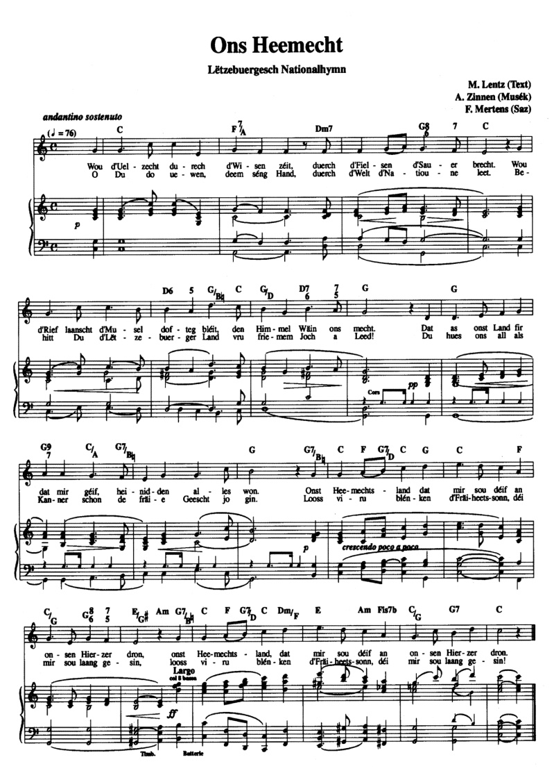
National Symbols
Ons Heemecht, the national anthem
Wou d'Uelzecht durech d'Wisen zéit, Duerch d'Fielsen d'Sauer brëcht. Wou d'Rief laanscht d'Musel dofteg bléit, Den Himmel Wäin ons mëcht. Dat as onst Land, fir dat mir géif, Heinidden alles won. Ons Heemechtsland, dat mir sou déif An onsen Hierzer dron.
O Du do uewen, deem séng Hand Duurch d'Welt d'Natioune leet. Behitt Du d'Lëtzebuerger Land Vru friemem Joch a Leed! Du hues ons all als Kanner schon de fräie Geescht jo gin. Looss viru blénken d'Fräiheetssonn déi mir sou laang gesin.
Notes:
National Symbols: national anthem
The national anthem, legally protected since 1993, consists of the first and last verse of the song Ons Heemecht (Our Homeland) of 1859, a poem in Luxembourgish by Michel Lentz that was set to music by Jean-Antoine Zinnen. Performed for the first time in public during a grand ceremony in Ettelbruck in 1864, the national anthem expresses the great joy felt by the country, which had finally achieved independence and delighted in its peace and prosperity. In 2014, Luxembourg celebrated the 150th anniversary of the first performance of the national anthem in Ettelbruck.
Solely the government has the right to translate the national anthem in other languages. Official translations are available online: www.luxembourg.public.lu/en/le-grand-duche-se-presente/symboles-nationaux/hymne/index.html
FOR MORE INFORMATION
“National Symbols”: www.luxembourg.public.lu/en/le-grand-duche-se-presente/symboles-nationaux/index.html
About... Symbols of the State and the Nation: www.luxembourg.public.lu/en/publications/d/ap-symboles/index.html
Everything You Need to Know about the Grand Duchy of Luxembourg: www.luxembourg.public.lu/en/publications/c/tout-savoir/index.html

Slide 25
National Symbols
De Wilhelmus, anthem of the Grand-Ducal house
Notes:
National Symbols: anthem of the Grand-Ducal house
De Wilhelmus is the anthem of the grand-ducal house. It is struck up whenever a member of the grand-ducal family arrives at or leaves an official ceremony. It was inspired by a trumpet call or cavalry fanfare, the first written trace of which dates back to the 16th century.
FOR MORE INFORMATION
“National Symbols”: www.luxembourg.public.lu/en/le-grand-duche-se-presente/symboles-nationaux/index.html
About... Symbols of the State and the Nation: www.luxembourg.public.lu/en/publications/d/ap-symboles/index.html
Everything You Need to Know about the Grand Duchy of Luxembourg: www.luxembourg.public.lu/en/publications/c/tout-savoir/index.html

Slide 26
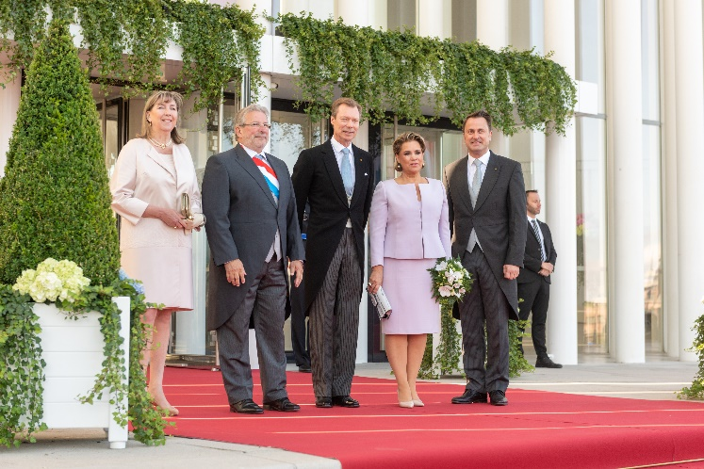
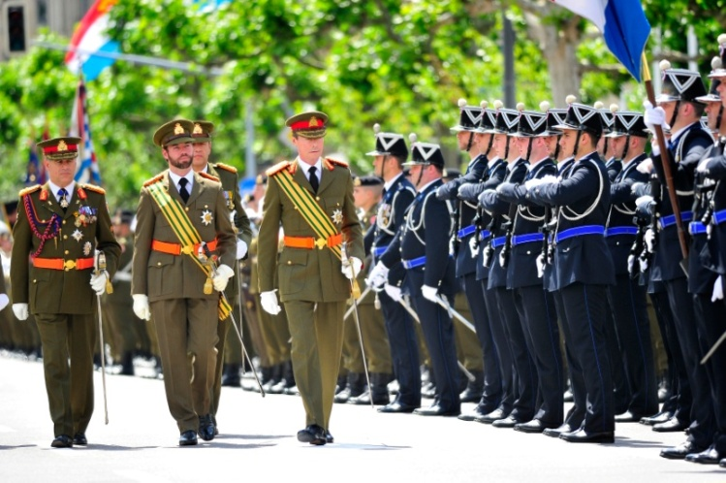
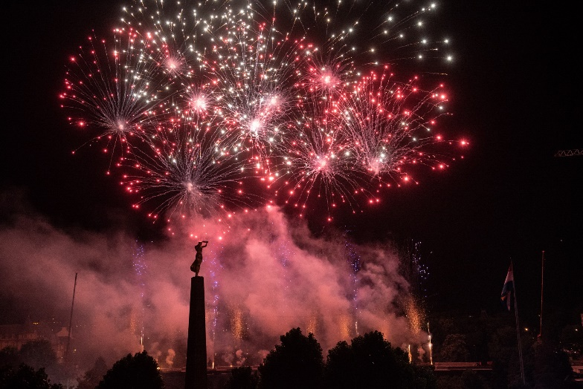
National Symbols
National day: 23 June
Notes:
National Symbols: National day
Ever since 1962, national day has been celebrated on 23 June: it celebrates the birthday of the sovereign, irrespective of his or her actual date of birth (grand-ducal decree of 23 December 1961). In 1961, largely for meteorological reasons, it was decided to permanently transfer the public celebration of the sovereign’s birthday and therefore national day to 23 June. Every year, national day celebrations attract tens of thousands of people from Luxembourg, foreign residents and tourists. In the capital Luxembourg City, festivities begin on the eve of 23 June with the ceremonial changing of the guard in front of the grand-ducal palace. While the grand-ducal couple visits a different town each year, the hereditary grand-ducal couple always pays a visit to Esch-sur-Alzette, the country’s second-largest city. After a torch-lit procession and a fireworks display, celebrations kick off throughout the capital’s public places with concerts and DJs. 23 June begins with an official civil ceremony at the Philharmonie Luxembourg. A grand military parade is held on Avenue de la Liberté, followed by an interfaith Te Deum at Notre-Dame Cathedral in Luxembourg. Images:
on the left, (from left to right) mayor of the city of Luxembourg; the president of the chamber of deputies; TRH the Grand Duke and Grand Duchess; the Prime Minister, Minister of State © SIP/Charles Caratini;
on the right, military parade © SIP/Nicolas Bouvy;
in the centre, fireworks in Luxembourg City on the eve of the national day © SIP/Charles Caratini.
FOR MORE INFORMATION
“National Symbols”: www.luxembourg.public.lu/en/le-grand-duche-se-presente/symboles-nationaux/index.html
About... Symbols of the State and the Nation: www.luxembourg.public.lu/en/publications/d/ap-symboles/index.html
Everything You Need to Know about the Grand Duchy of Luxembourg: www.luxembourg.public.lu/en/publications/c/tout-savoir/index.html

Slide 27
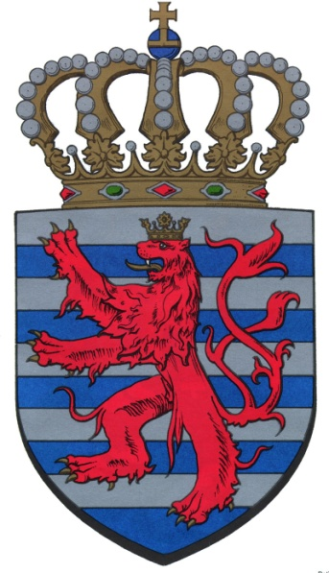
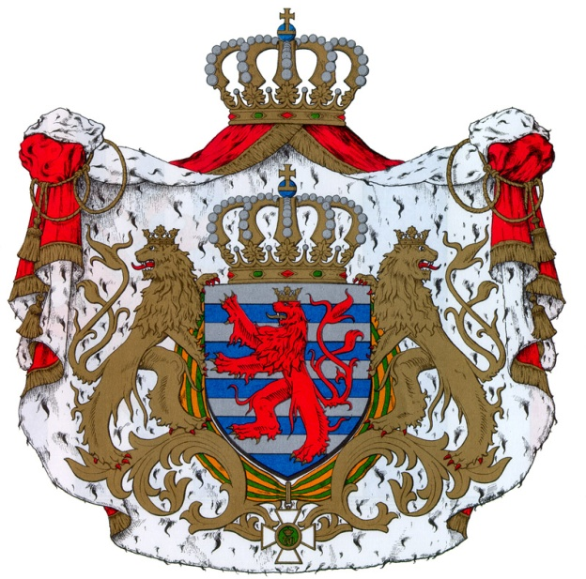
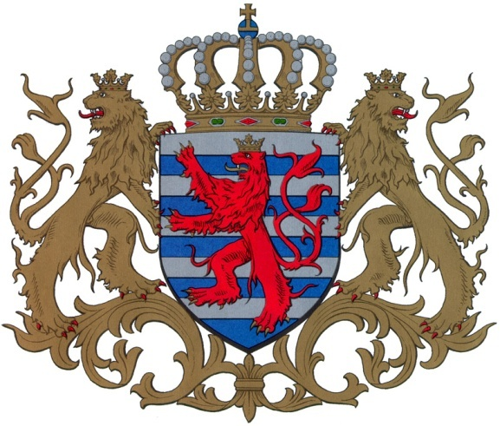
National Symbols
Coats of arms
Lesser coat of arms
Middle coat of arms
Greater coat of arms
Notes:
National Symbols: Coats of arms
The origins of the state of Luxembourg’s coat of arms date back to the Middle Ages.
The coat of arms of the Grand Duchy of Luxembourg comes in three levels: lesser, middle and greater.
They are protected by the law of 23 June 1972 on national emblems.
You can see:
- on the left: the lesser coat of arms;
- in the centre: the middle coat of arms;
- on the right: the greater coat of arms.
FOR MORE INFORMATION
“National Symbols”: www.luxembourg.public.lu/en/le-grand-duche-se-presente/symboles-nationaux/index.html
About... Symbols of the State and the Nation: www.luxembourg.public.lu/en/publications/d/ap-symboles/index.html
Everything You Need to Know about the Grand Duchy of Luxembourg: www.luxembourg.public.lu/en/publications/c/tout-savoir/index.html

Slide 28
Festival and Traditions
Liichtmëssdag (Candlemas, 2 February)
Fuesend (Carnival, from 2 February to Ash Wednesday)
Buergbrennen (driving out the winter, 1st Sunday of Lent)
Bretzelsonndeg (Pretzel Sunday, 4th Sunday of Lent)
Oktav und Mäertchen (Oktav pilgrimage, 3rd Sunday after Easter)
Echternach hopping procession (Unesco Representative List of the Intangible Cultural Heritage of Humanity, Whit Tuesday)
National Day (23 June)
Schueberfouer (funfair in Luxembourg City, August – September)
Kleeschen (St Nicholas, 6 December)
Notes:
Festivals and Traditions
Like other countries, Luxembourg also celebrates Easter and Christmas, as well as other religious-themed occasions. Nevertheless, the Grand Duchy also has its own typically Luxembourg festivals and traditions. The most important or distinctive ones are:
Liichtmëssdag (Candlemas)
Fuesend (officially Carnival goes from 2 February to Ash Wednesday, but in reality it continues until mid-Lent)
Buergbrennen (driving out winter)
Bretzelsonndeg (Pretzel Sunday)
Oktav and Mäertchen (Oktav pilgrimage)
Echternach hopping procession (Whit Tuesday)
National day (23 June)
Schueberfouer (funfair in Luxembourg City)
- Kleeschen (6 December)
FOR MORE INFORMATION
“Festivals and Traditions”: www.luxembourg.public.lu/en/le-grand-duche-se-presente/fetes-traditions/index.html
About… Festivals and Traditions in Luxembourg: www.luxembourg.public.lu/en/publications/a/apropos-fetes-traditions/index.html

Slide 29
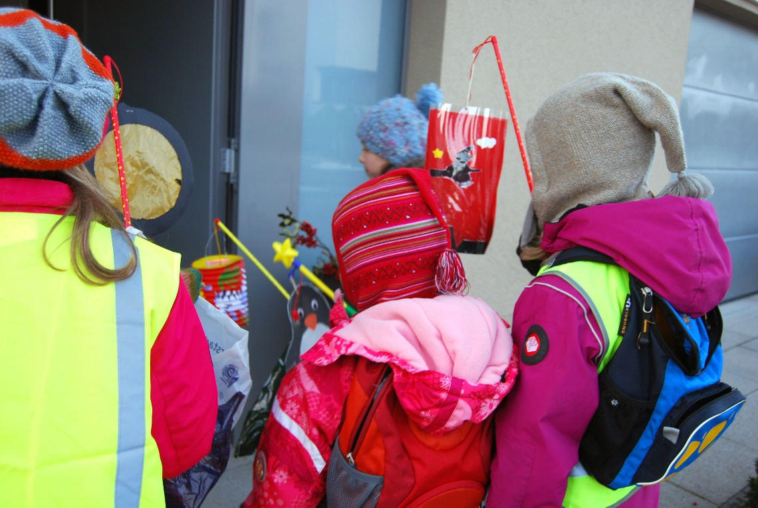
Festivals and Traditions
Liichtmëssdag, Candlemas, 2 February
Léiwer Härgottsblieschen, Gitt ons Speck an Ierbessen Ee Pond, zwee Pond, Dat anert Joer da gitt der gesond, Da gitt der gesond. Loosst déi jonk Leit liewen Loosst déi al Leit stierwen, (Variante: an déi al derniewent) Kommt der net bal, D'Féiss ginn ons kal. Kommt Der net gläich, Da gi mer op d'Schläich. Kommt der net geschwënn, D'Féiss ginn ons dënn. Kommt Der net gewëss, Da kritt Der e Schouss voll Nëss.
Notes:
Festivals and Traditions: Liichtmëssdag (Candlemas)
- Every year, on 2 February, children are liichten (celebrating the light).
Armed with lanterns, they go from house to house in groups requesting sweets and coins to the tune of St Blaise: ‘Léiwer Herrgottsblieschen, gëff ons Speck an Ierbessen…’.
Image:
Children are liichten © SIP
FOR MORE INFORMATION
“Festivals and Traditions”: www.luxembourg.public.lu/en/le-grand-duche-se-presente/fetes-traditions/index.html
About… Festivals and Traditions in Luxembourg: www.luxembourg.public.lu/en/publications/a/apropos-fetes-traditions/index.html

Slide 30
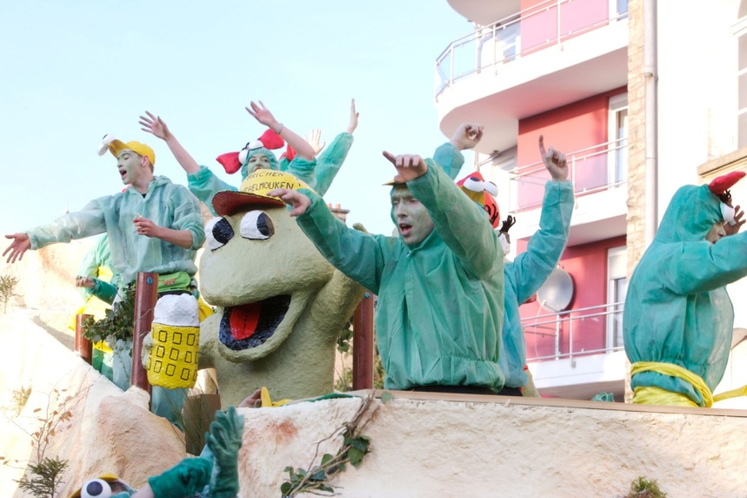
Festivals and Traditions
Fuesend, Carnival, from 2 February to Ash Wednesday
Notes:
Festivals and Traditions: Fuesend (Carnival)
- Much like their German neighbours, the Luxembourg people love celebrating Carnival with costume balls and cavalcades.
Carnival officially goes from 2 February (Liichtmëssdag) to Ash Wednesday (Äschermëttwoch), but in reality it continues until mid-Lent.
Images: on the left, doughnuts © SIP; on the right, carnival parade © SIP/Jean-Paul Kieffer.
FOR MORE INFORMATION
“Festivals and Traditions”: www.luxembourg.public.lu/en/le-grand-duche-se-presente/fetes-traditions/index.html
About… Festivals and Traditions in Luxembourg: www.luxembourg.public.lu/en/publications/a/apropos-fetes-traditions/index.html

Slide 31
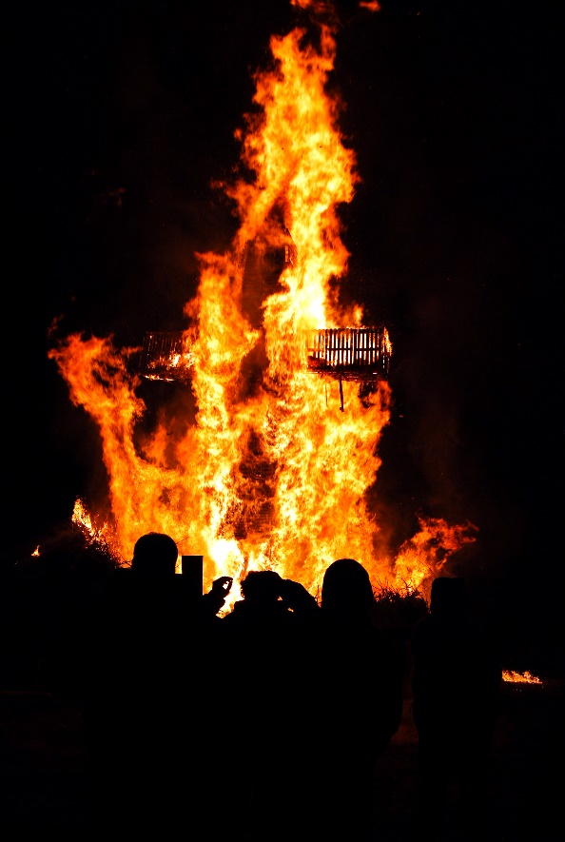
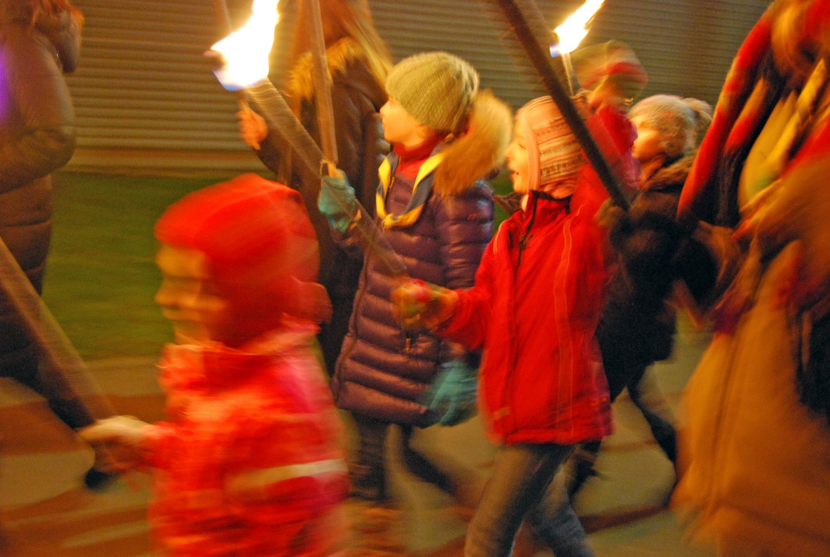
Festivals and Traditions
Buergbrennen, driving out the winter, first Sunday of Lent
Notes:
Festivals and Traditions: Buergbrennen (burning of the cross)
- On the first Sunday of Lent, Buergen (cross stakes) are set alight throughout the country to chase away the winter;
Traditional festival each year attracting thousands of people in different parts of the country.
Images: on the left, burning cross stake © SIP; on the right, children with torches to chase away winter © SIP.
FOR MORE INFORMATION
“Festivals and Traditions”: www.luxembourg.public.lu/en/le-grand-duche-se-presente/fetes-traditions/index.html
About… Festivals and Traditions in Luxembourg: www.luxembourg.public.lu/en/publications/a/apropos-fetes-traditions/index.html

Slide 32
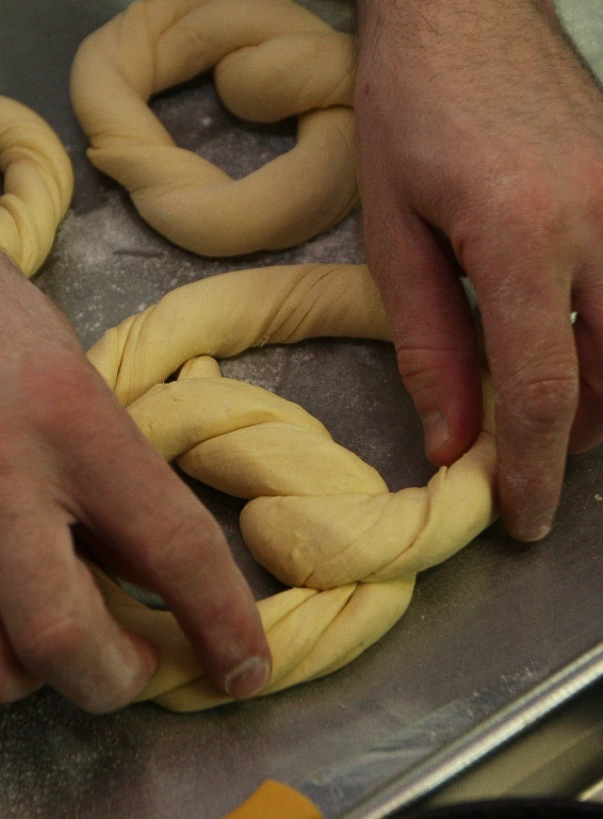
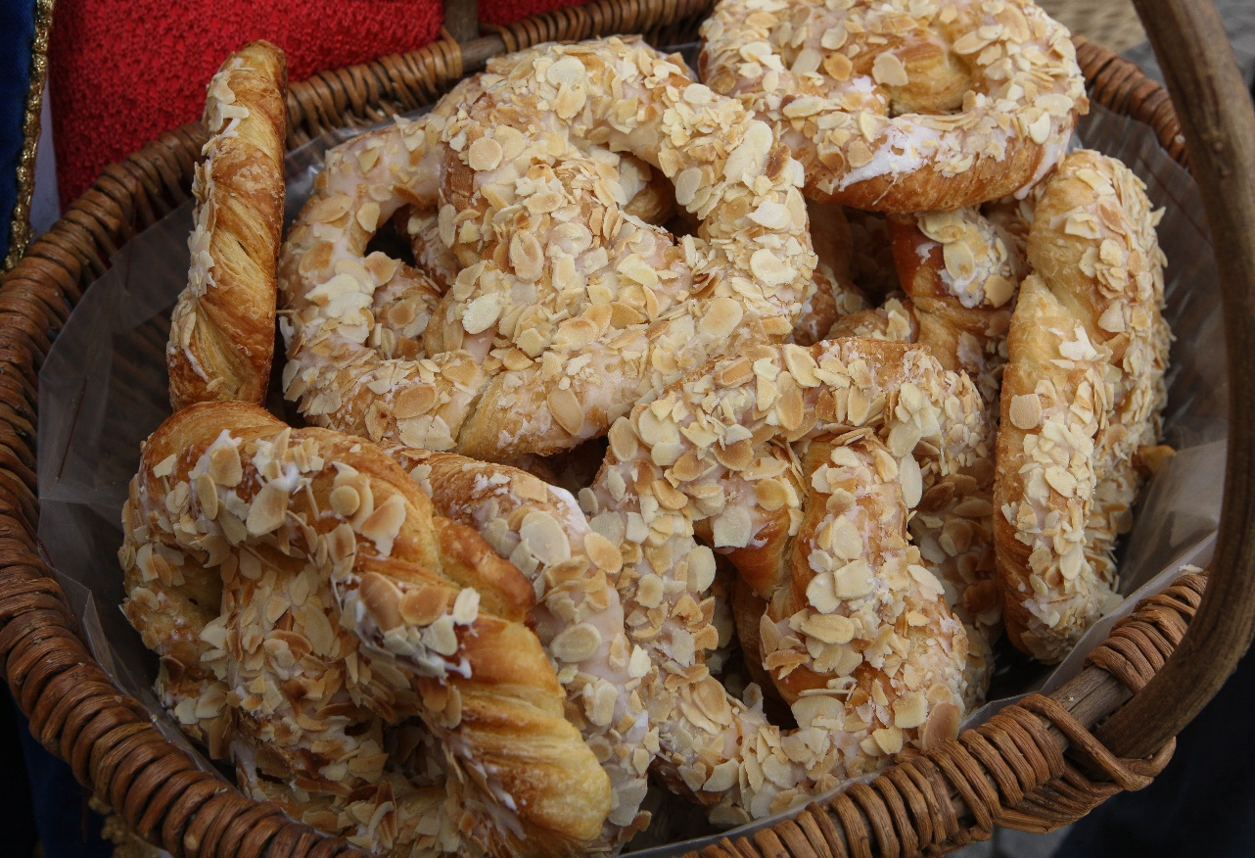
Festivals and Traditions
Bretzelsonndeg, Pretzel Sunday, 4th Sunday of Lent
Notes:
Festivals and Traditions: Bretzelsonndeg (Pretzel Sunday)
On the fourth Sunday of Lent (known as Bretzelsonndeg), tradition dictates that men give their sweethearts a popular pastry known as a Bretzel (pretzel).
If the woman accepts the pretzel, the man may come back on Easter Sunday to receive (chocolate) eggs in return.
On a leap year, the tradition is reversed: the ladies are the ones offering the pretzels.
Images: on the left, preparing pretzels © SIP/Zineb Ruppert; on the right, basket with pretzels © SIP/Zineb Ruppert.
FOR MORE INFORMATION
“Festivals and Traditions”: www.luxembourg.public.lu/en/le-grand-duche-se-presente/fetes-traditions/index.html
About… Festivals and Traditions in Luxembourg: www.luxembourg.public.lu/en/publications/a/apropos-fetes-traditions/index.html

Slide 33
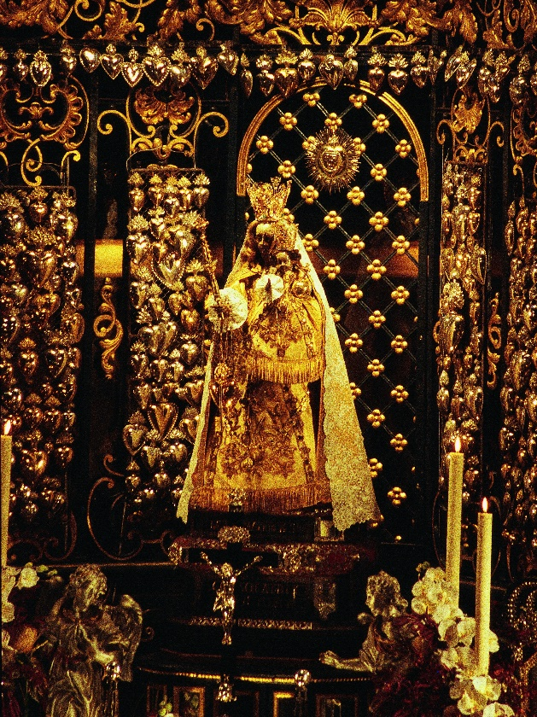
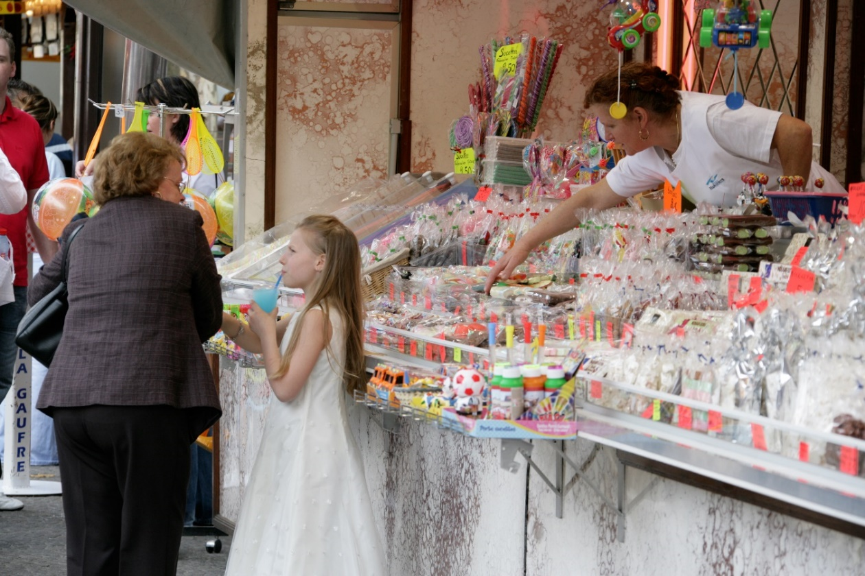
Festivals and Traditions
Oktav and Mäertchen
Notes:
Festivals and Traditions: Oktav and Mäertchen
Oktav
- The most important religious event of the year to take place in Luxembourg City;
- Annual pilgrimage in honour of Our Lady of Luxembourg, conducted over a fortnight towards the second half of April;
Every year, it attracts 60,000 pilgrims;
Its origins date back to the 17th century.
The Oktav is traditionally accompanied by a market on Knuedler (Place Guillaume II) and Place de la Constitution, known as the Mäertchen (small market). Originally, the market’s sole purpose was to allow pilgrims to have something to eat after mass and to purchase a few souvenirs and religious items. Over time, several more stands joined the Mäertchen and it has gradually transformed into a popular fair.
Images: on the left, Notre-Dame Cathedral in Luxembourg during Oktav © SIP/Marcel Schmitz; on the right, Mäertchen © SIP/Jean-Paul Kieffer.
FOR MORE INFORMATION
“Festivals and Traditions”: www.luxembourg.public.lu/en/le-grand-duche-se-presente/fetes-traditions/index.html
About… Festivals and Traditions in Luxembourg: www.luxembourg.public.lu/en/publications/a/apropos-fetes-traditions/index.html

Slide 34
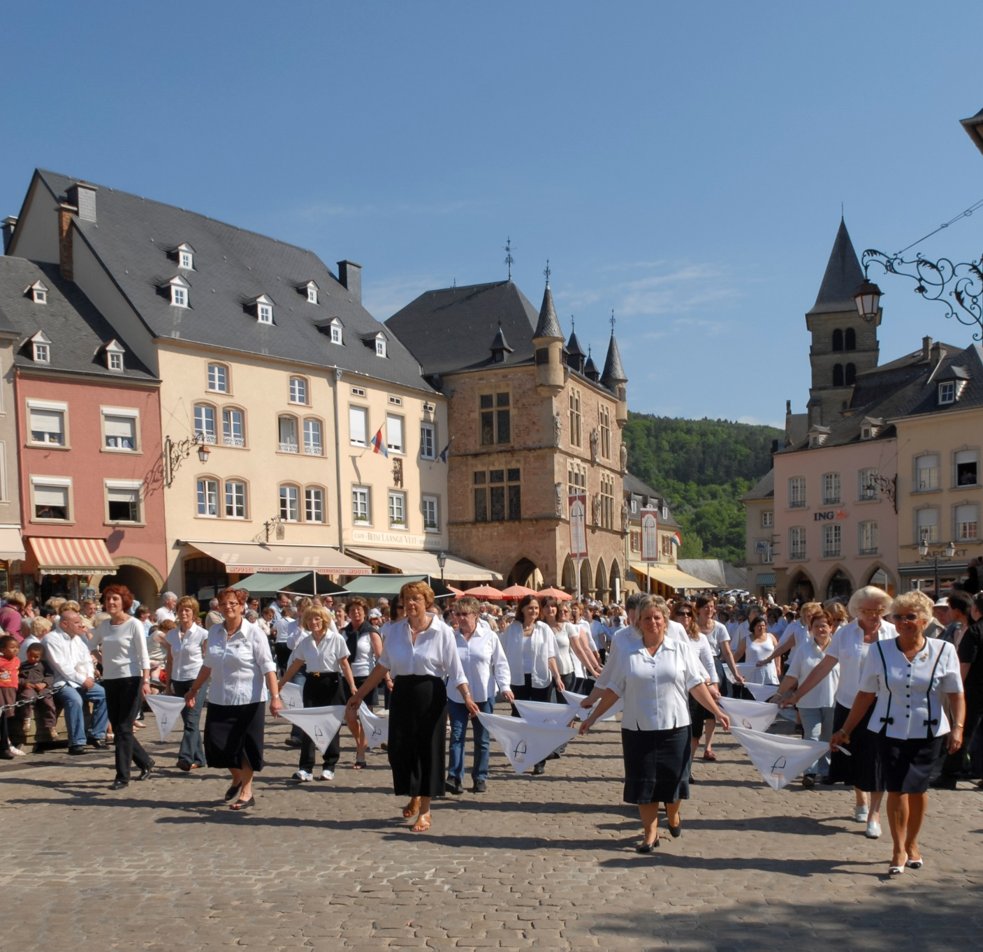
Festivals and Traditions
Echternach Hopping Procession
Notes:
Festivals and Traditions: Echternach Hopping Procession
- Included on the Unesco Representative List of the Intangible Cultural Heritage of Humanity;
Takes place on Whit Tuesday;
- Procession in tribute to St Willibrord, Irish monk who founded the abbey of Echternach during the 7th century;
Origins (both pagan and religious) date back to the 13th century;
Only hopping procession in Europe;
More than 10,000 participants every year.
Image:
Echternach hopping procession © MECO, LFF, CC et al./Géry Oth
FOR MORE INFORMATION
La procession dansante d’Echternach, Unesco film about the Echternach Hopping Procession on youtube.com (duration: 5’20): www.youtube.com/watch?v=FQ68OFEC_p8 (in French)
“Festivals and Traditions”: www.luxembourg.public.lu/en/le-grand-duche-se-presente/fetes-traditions/index.html
About… Festivals and Traditions in Luxembourg: www.luxembourg.public.lu/en/publications/a/apropos-fetes-traditions/index.html

Slide 35
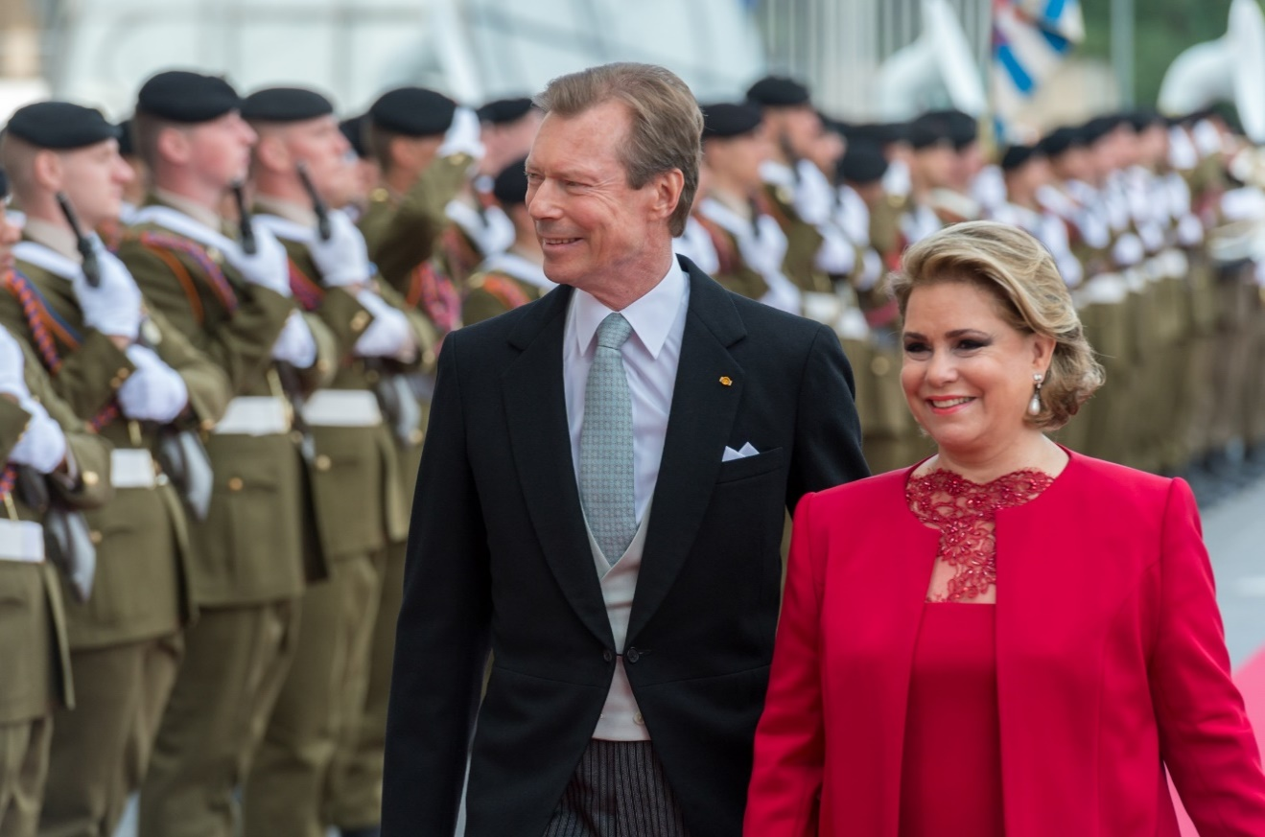
Festivals and Traditions
National day: 23 June
Notes:
Festivals and Traditions: National day (23 June)
- Celebration of the sovereign’s birthday;
- Torch-lit procession, fireworks display and jubilant crowds on the eve of 23 June;
Official civil ceremony at the Philharmonie Luxembourg and grand military parade on 23 June.
Images:
on the left, national flag © SIP/Charles Caratini;
on the right, TRH the grand-ducal couple on the national day © SIP/Emmanuel Claude.
FOR MORE INFORMATION
See also Slide 25
“Festivals and Traditions”: www.luxembourg.public.lu/en/le-grand-duche-se-presente/fetes-traditions/index.html
About… Festivals and Traditions in Luxembourg: www.luxembourg.public.lu/en/publications/a/apropos-fetes-traditions/index.html
About... Symbols of the state and of the nation: www.luxembourg.public.lu/en/publications/d/ap-symboles/index.html
Everything You Need to Know about the Grand Duchy of Luxembourg: www.luxembourg.public.lu/en/publications/c/tout-savoir/index.html

Slide 36
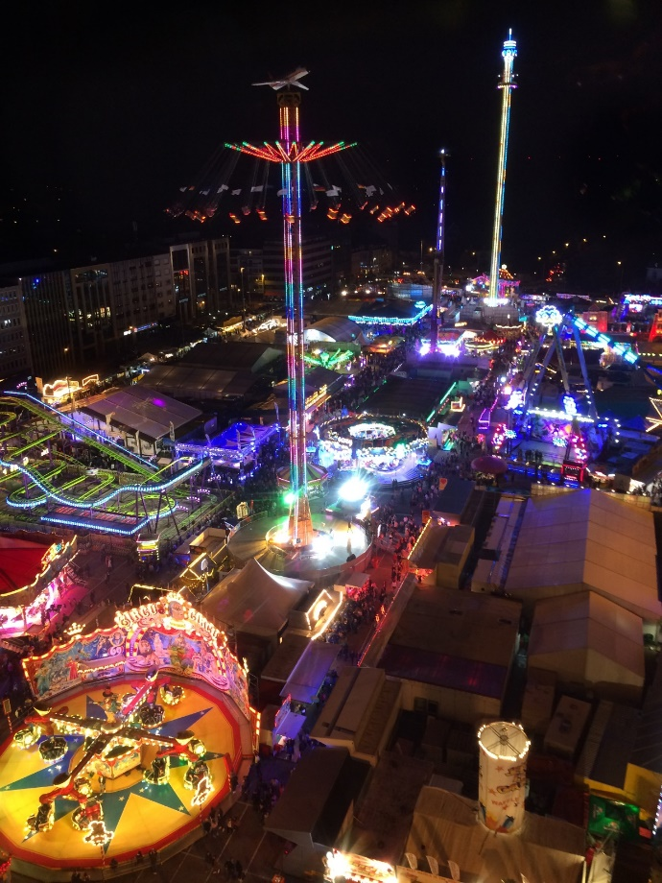
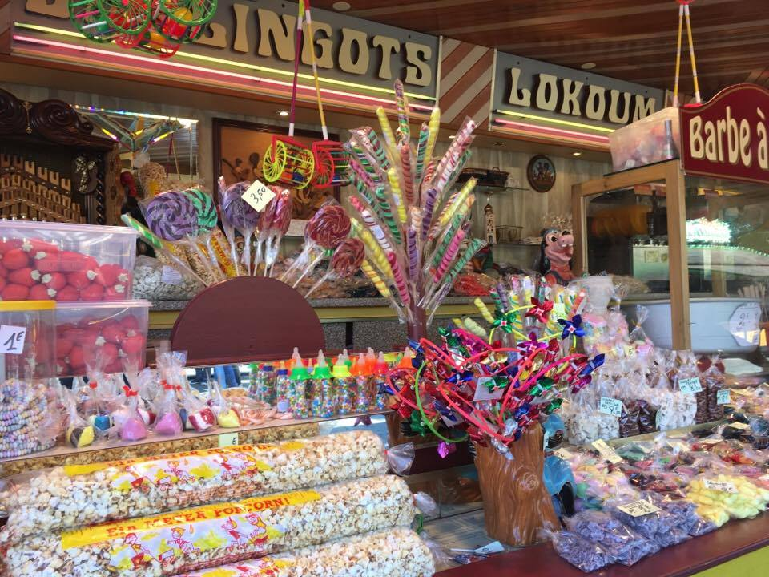
Festivals and Traditions
Schueberfouer, funfair in Luxembourg City, from late August to early September
Notes:
Festivals and Traditions: Schueberfouer (funfair)
- Funfair in Luxembourg City, founded in 1340 by John the Blind;
- The Schueberfouer takes place from late August to early September;
The largest funfair in Luxembourg and the Greater Region: attracting more than 2 million visitors each year on the 4-hectare Glacis ground, not far from the city centre.
Images: on the left, nocturnal view of the Schueberfouer from the Ferris wheel © SIP; on the right, gastronomic stand on Schueberfouer © SIP.
FOR MORE INFORMATION
“Festivals and Traditions”: www.luxembourg.public.lu/en/le-grand-duche-se-presente/fetes-traditions/index.html
About… Festivals and Traditions in Luxembourg: www.luxembourg.public.lu/en/publications/a/apropos-fetes-traditions/index.html

Slide 37
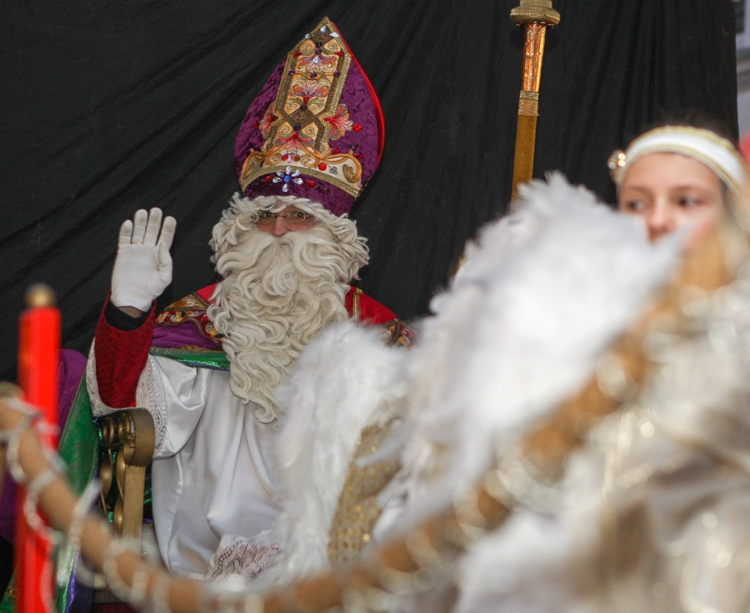
Festivals and Traditions
Kleeschen, St Nicholas, 6 December
Léiwe Kleeschen
Léiwe Kleeschen, gudde Kleeschen Bréng eis Saachen, allerhand, Fir ze kucken, fir ze schmaachen, Aus dem schéinen Himmelsland. Bei der Dier do stinn eis Telleren Beieneen an enger Rei 'T läit och Hee do fir Däin Iesel Dofir bréng ons Spillgezei.
Notes:
Festival and Traditions: Kleeschen (St Nicholas)
In Luxembourg, Kleeschen is synonymous with an elderly bearded gentleman with white hair and dressed in red.
In contrast to Father Christmas, St Nicholas wears a mitre, a red pointed headdress, and carries a crozier, a type of staff.
He is most often accompanied by the Houseker (his fear-inspiring helper), who leaves switches for children who have been naughty.
In Luxembourg, this celebration is so important that the Ministry of Education, Children and Youth decided that, on 6 December, children in fundamental education get the day off school. In the days preceding 6 December, Kleeschen visits fundamental education classes.
As early as late November, children put one slipper outside their bedroom door every night so that Kleeschen can bring them sweets before appearing during the night of 5 to 6 December with proper gifts (toys and confectionery). Generally, his presence goes unseen by little children who wake up early in the morning to discover all their gifts.
Image: Saint Nicholas © SIP/Zineb Ruppert
FOR MORE INFORMATION
“Festivals and Traditions”: www.luxembourg.public.lu/en/le-grand-duche-se-presente/fetes-traditions/index.html
About… Festivals and Traditions in Luxembourg: www.luxembourg.public.lu/en/publications/a/apropos-fetes-traditions/index.html

Slide 38
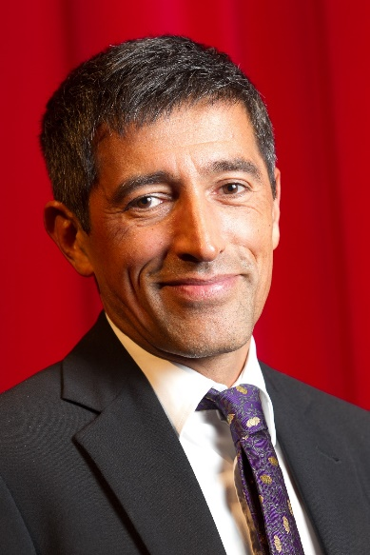
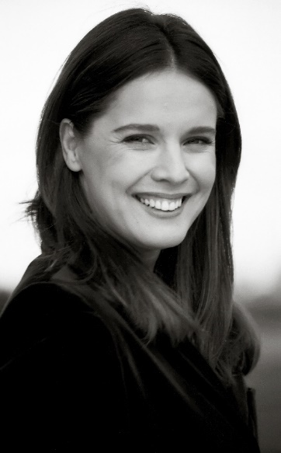
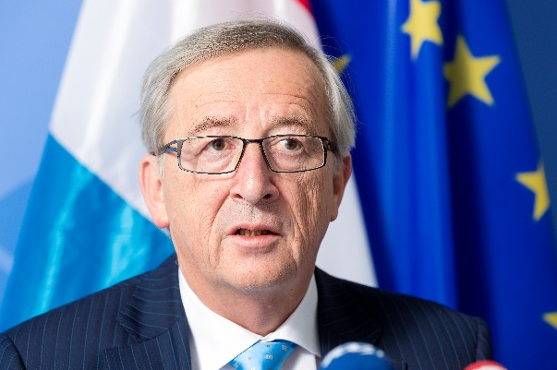
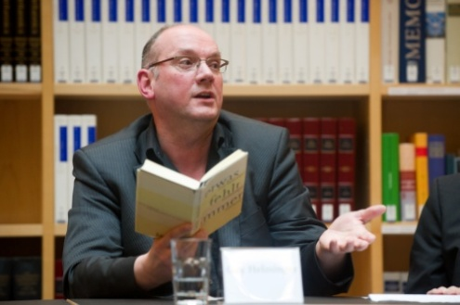
Famous Luxembourg People
Jean-Claude Juncker
Ranga Yogeshwar
Désirée Nosbusch
Guy Helminger
Léa Linster
Christine Majerus
Notes:
Famous Luxembourg People
- Ranga Yogeshwar is physician and scientific journalist. Since 1989 he has presented numerous science programmes on German TV and his books have been translated into several languages. He has been awarded numerous distinctions for his work as journalist, as well as for his commitment to research and culture.
Jean-Claude Juncker has been serving as President of the European Commission since November 2014. As Prime Minister of Luxembourg from 1995 to 2013, he served as the first permanent President of the Eurogroup (2005 – 2013). He has been awarded numerous distinctions and national honours, among which the Charlemagne Prize in 2006.
Désirée Nosbusch is an actress and television presenter. She was born in Esch-sur-Alzette and started her career at the age of 12 with the radio programme of RTL. She has presented numerous events and can regularly be seen in television films. She has also worked as film producer and director.
Guy Helminger is a writer. He lives in Cologne where he writes poems, radio and theatre plays and novels in German. In 2002, he received the Prix Servais, a literature prize in Luxembourg. He has also presented a cultural programme with RTL Télé Lëtzebuerg.
Christine Majerus is a cyclist and has represented Luxembourg at the Olympic Games. Between 2007 and 2016, she has won the title of national champion 28 times. 2016, she became world champion in the women’s team time trial.
Léa Linster is a chef. She is the first and, to date, only woman to have won the Bocuse d’or, one of the most prestigious cooking competitions for professional chefs. In 1987, she received a Michelin star. She is often seen on German TV and has published numerous articles and cook books.
Images: Ranga Yogeshwar © SIP/Claude Piscitelli; Jean-Claude Juncker © SIP/Thierry Monasse; Désirée Nosbusch © SIP/Jean-Paul Kieffer; Guy Helminger © SIP/Charles Caratini; Christine Majerus © George Deswijzen / Boels-Dolmans Cycling Team – Source: Christine Majerus; Léa Linster © SIP/Claude Piscitelli.

Slide 39
Did you know that…?
three researchers of Luxembourg origin have won a Noble Prize?
the Luxembourger Pierre Werner is considered the “forefather of the euro”?
the only woman in the world to have won a Bocuse d’or is from Luxembourg?
Robert Schuman, one of the founding fathers of Europe, was born in Luxembourg City?
four Luxembourgers have won the Tour de France?
the father of science fiction was Luxembourgish?
Notes:
Did you know that…?
… three researchers of Luxembourg origin have won a Noble Prize? Gabriel Lippmann, born in Luxembourg in 1845, was awarded the Nobel Prize in Physics in 1908. Paul Lauterbur, an American of Luxembourg origin born in 1929, won the Nobel Prize in Medicine in 2003. And Jules Hoffmann, born in Luxembourg in 1941, was awarded the Nobel Prize in Medicine in 2011. This means Luxembourg has the highest number of Nobel Prize recipients in the world on a per-capita basis!
… Luxembourger Pierre Werner is considered the ‘forefather of the euro’?
During his time as Prime Minister, Pierre Werner (1913-2002) was appointed to head a European group of experts and in 1970 presented the European Commission with a monetary integration project known as the ‘Werner Plan’, which can be considered the beginning of the euro.
… the only woman in the world to have won a Bocuse d’or is from Luxembourg? Léa Linster, owner of the eponymous Michelin-starred restaurant, is the first and, to this date, only woman to have won this prestigious award.
… Robert Schuman, one of the founding fathers of Europe, was born in Luxembourg City?
Robert Schuman was born in Clausen, a suburb of Luxembourg City, to a Lorraine father of German nationality and a mother from Luxembourg. His mother tongue was therefore Luxembourgish. It is often mentioned that Robert Schuman’s personality was influenced by his origins. The combination of these Luxembourgish, German and French influences doubtlessly prompted him to launch a plan that was to result in the creation of the first European Community.
… four Luxembourgers have won the Tour de France?
François Faber won the Tour de France in 1909, Nicolas Frantz won in 1927 and 1928, Charly Gaul – dubbed the ‘Angel of the mountain’ – won in 1958 and Andy Schleck won in 2010.
…. the father of science fiction was from Luxembourg? Hugo Gernsback was a scientist born in Luxembourg on 16 August 1884. Among other things, he invented the dry cell battery, the wireless radio, the synthesiser, the transistor without aerial and the lie detector. Over the course of his life, he filed more than 80 patents. His real passion, however, was writing science fiction novels. Incidentally, he was the one to invent the term ‘science fiction’, which was quickly adopted the world over.

Slide 40
Did you know that…?
three elements of Luxembourg’s heritage are officially recognised by Unesco?
23 km of passages that date back to the times of the fortress and are known as ‘Kasematten’ run beneath Luxembourg City?
Luxembourg is the only city to have been chosen as European Capital of Culture on two occasions?
Notes:
Did you know that…?
… three elements of Luxembourg‘s heritage are officially recognised by Unesco? The fortifications and old quarters of the City of Luxembourg have been registered on the Unesco World Heritage List since 1994; the photography exhibition ‘The Family of Man’ by Edward Steichen was added to the Unesco Memory of the World Register in 2003 and the Echternach hopping procession was registered on the Unesco Representative List of the Intangible Cultural Heritage of Humanity in 2010.
… 23 km of passages that date back to the times of the fortress and are known as ‘Kasematten’ run beneath Luxembourg City?
Indeed, the casemates of the Bock Casemates and those of the Petrusse Valley form an extraordinary network of 23 km of underground galleries and more than 40,000 m² housed in the rocks of the city. The Casemates of the Bock, which counted about fifty guns, were dug by the Austrians in 1745/46. During the two world wars, they served as a shelter to protect up to 35,000 people in case of alarm or bombing.
… Luxembourg is the only city to have been chosen as European Capital of Culture on two occasions? Luxembourg City was the European Capital of Culture in both 1995 and 2007. In 2007, it was the first city to suggest including surrounding regions, i.e. the Greater Region (Saar and Rhineland-Palatinate in Germany, Lorraine in France and Wallonia in Belgium) in this event.

Slide 41
Did you know that…?
Luxembourg contributes around 1% of its GNI to official development assistance?
Luxembourg is the main global listing centre for green bonds?
Luxembourg has promulgated the first European law on the exploitation of space resources?
the Grand Duchy is at the top of the ranking of global health systems?
Notes:
Did you know that…?
… Luxembourg contributes around 1% of its GNI to official development assistance? Since 2009, Luxembourg has been contributing around 1% of its gross national income (GNI) to official development assistance, thus ranking among the five most generous countries in the world.
… Luxembourg is the main global listing centre for green bonds?
The Luxembourg Green Exchange (LGX), founded in 2016, is the world’s first stock exchange to restrict itself to environment-friendly financial products. Representing almost half of all listed green bonds, the Grand Duchy’s new green exchange is the world leader on the market.
… Luxembourg has promulgated the first European law on the exploitation of space resources?
The law on space resources was passed on 13 July at the Luxembourg Chamber of Deputies, obtaining a large majority with 55 votes in favour. It has come into force on 1 August 2017. Luxembourg is thus the first European country to implement legislation giving private operators assurances regarding the ownership of the resources that they extract in space.
… the Grand Duchy is at the top of the ranking of global health systems?
According to the latest figures in the “Legatum Prosperity Index“ report of the Legatum Institute, Luxembourg‘s healthcare system remains among the best in the world. Luxembourg, together with Norway, Switzerland and the United States, belongs to the countries that spent the most on their healthcare provision (Luxembourg: 6% of its GNI). In 2017, only 1.4% of medical expenses were borne by Luxembourg households, i.e. the lowest rate amongst OECD member countries. 95,2% of the population are covered by health insurance.

